Slide 1
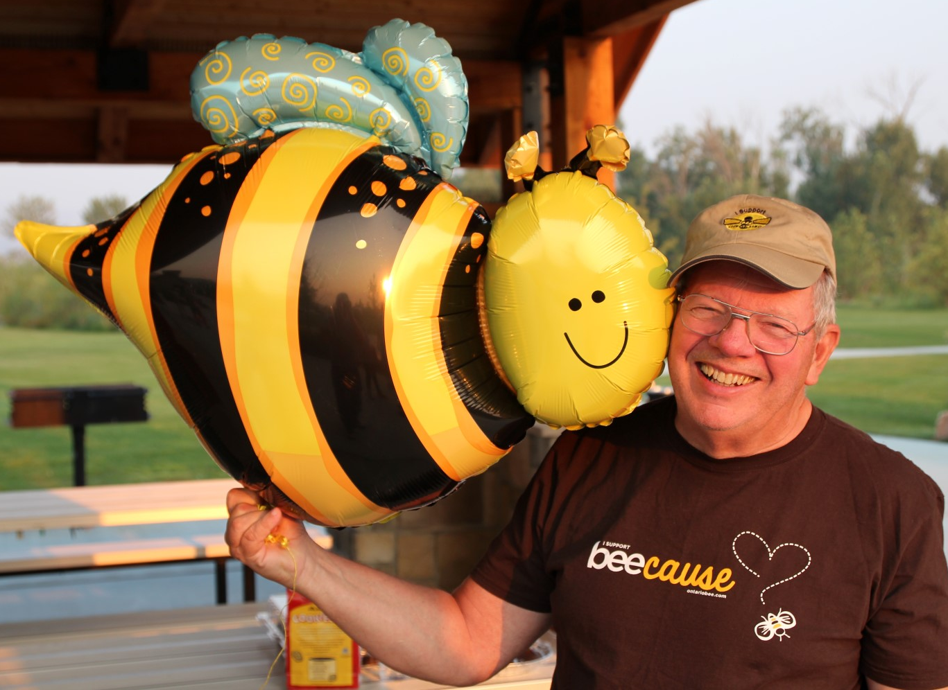
Treasure Valley Beekeepers Club
National Honey Bee Day 2015

Slide 2
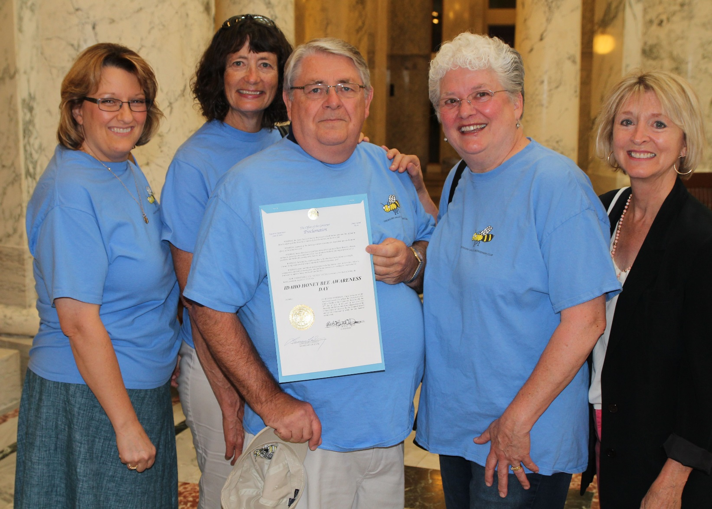
Treasure Valley Beekeepers Club
National Honey Bee Day 2015
Governor’s Proclamation: Idaho Honey Bee Awareness Day

Slide 3
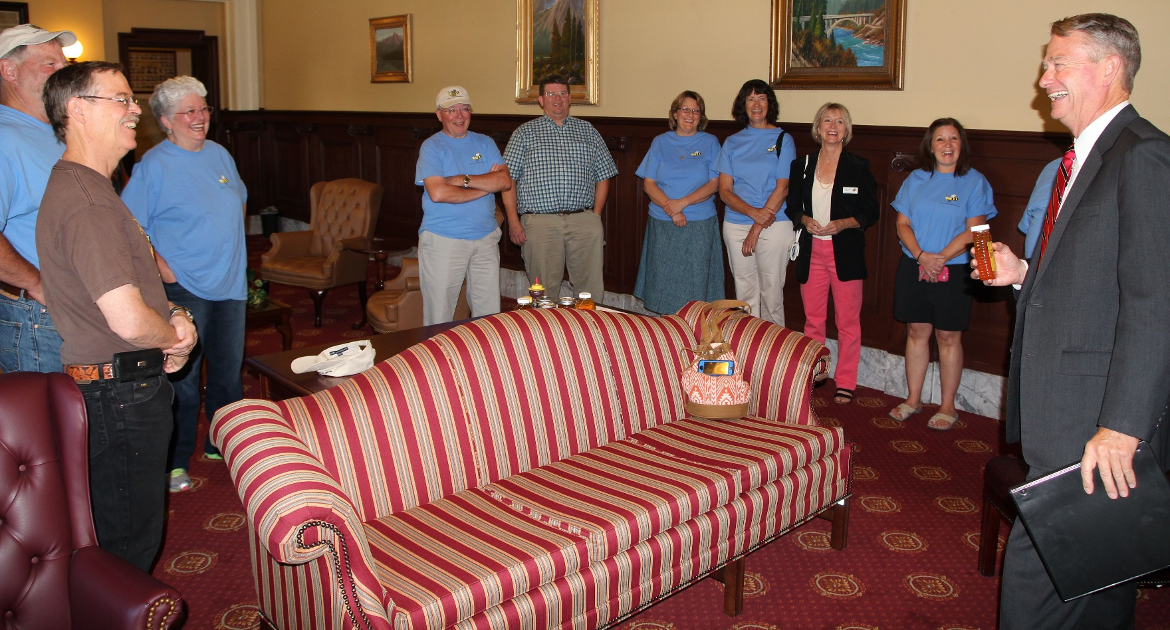
Treasure Valley Beekeepers Club
National Honey Bee Day 2015

Slide 4
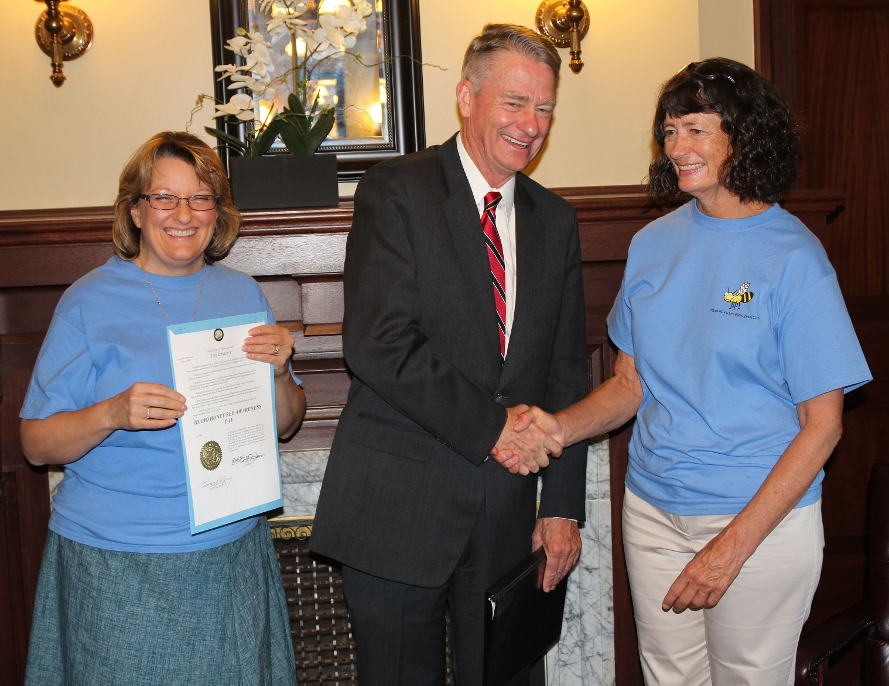
Treasure Valley Beekeepers Club
National Honey Bee Day 2015

Slide 5
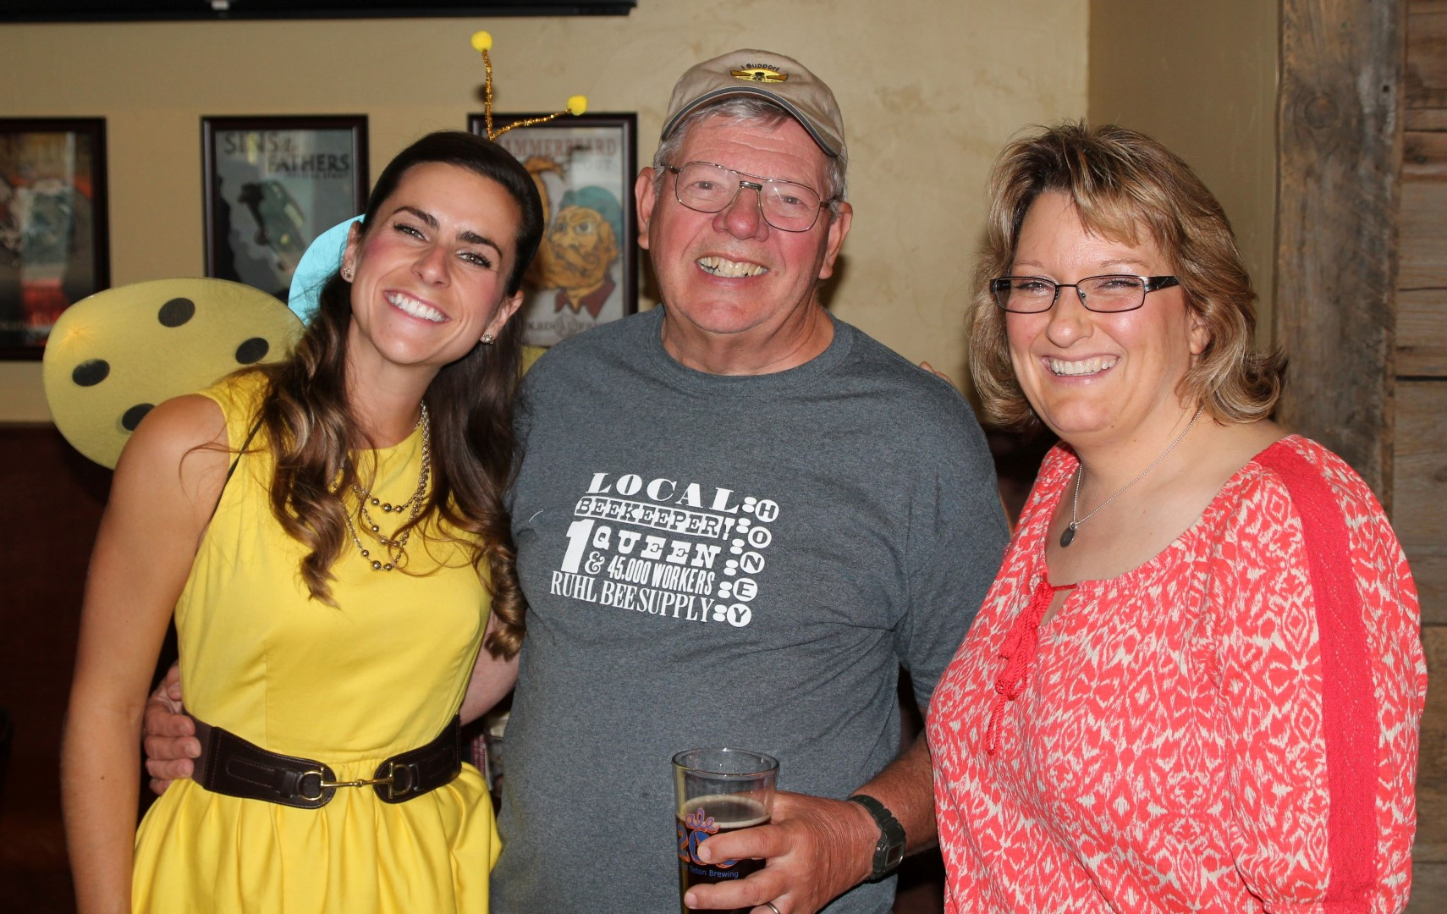
Treasure Valley Beekeepers Club
National Honey Bee Day 2015
TVBC – National Honey Bee Day Events Kick-Off: Pub Swarm

Slide 6
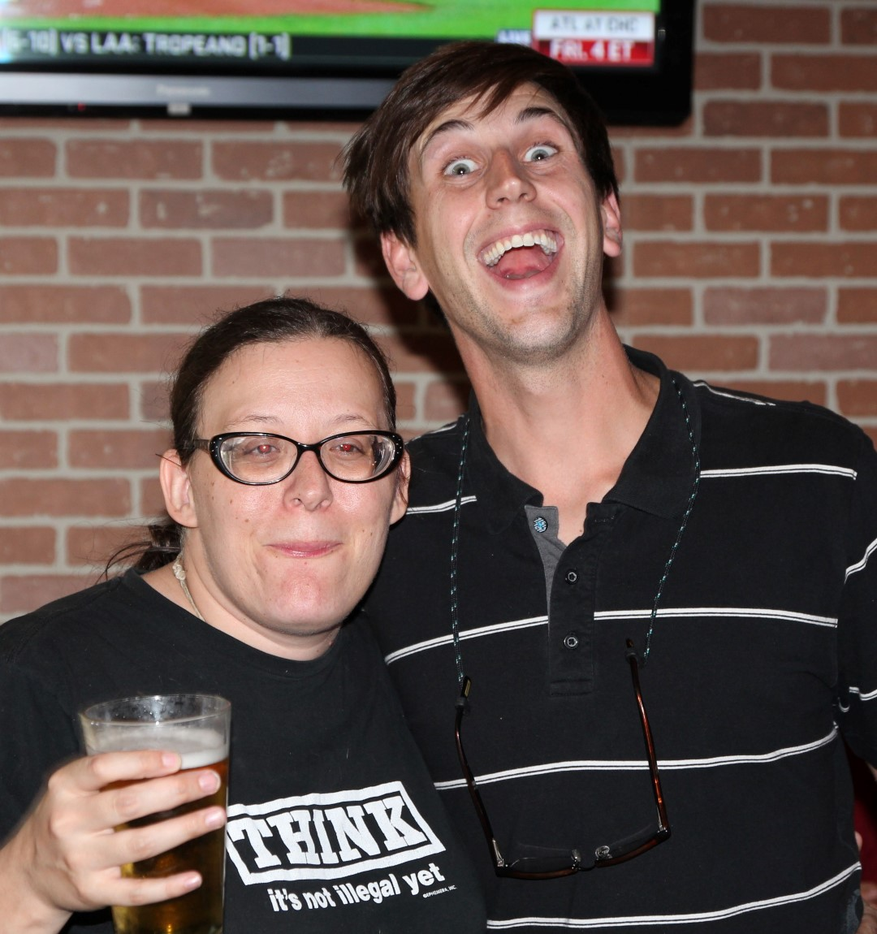
Treasure Valley Beekeepers Club
National Honey Bee Day 2015

Slide 7
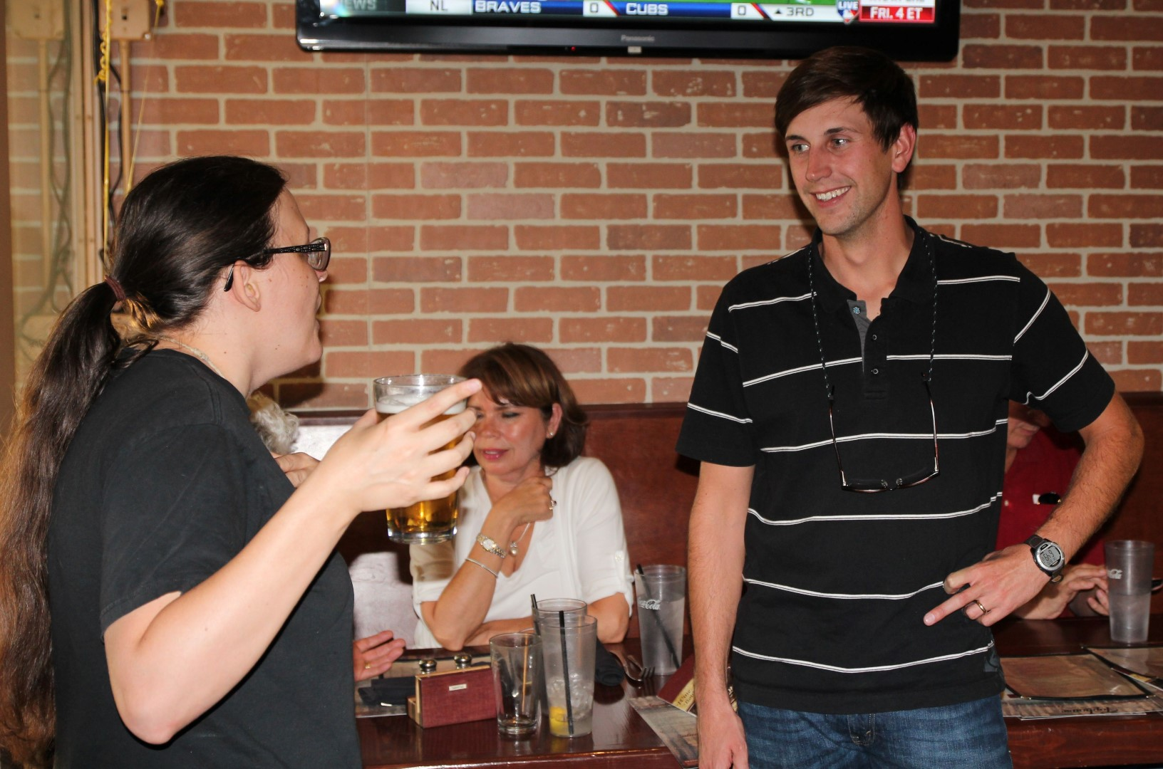
Treasure Valley Beekeepers Club
National Honey Bee Day 2015

Slide 8
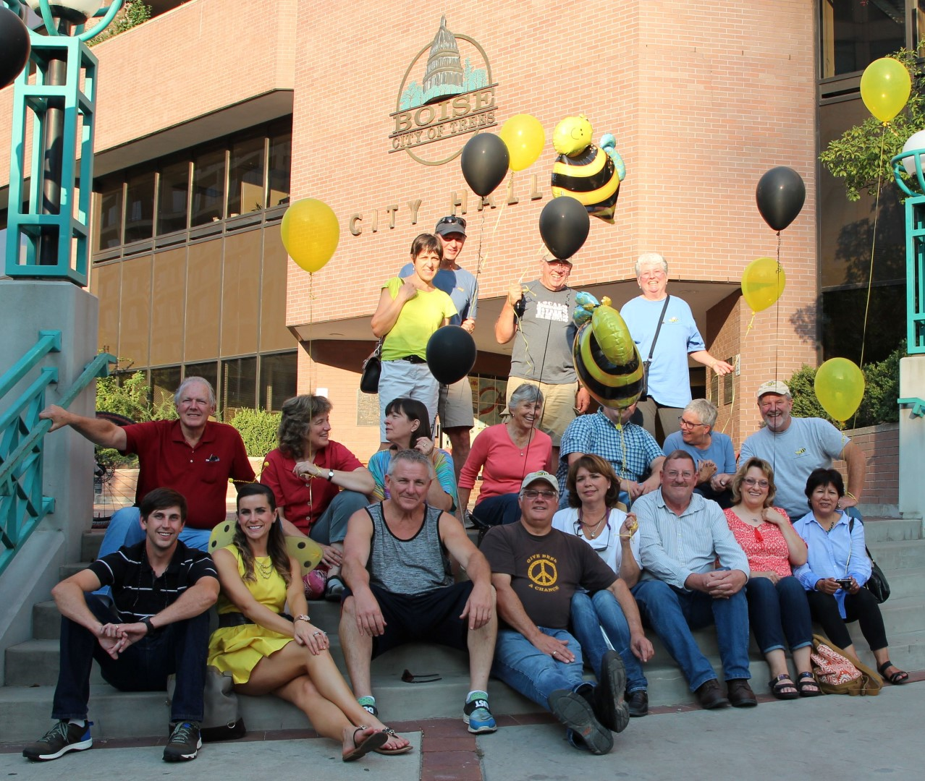
Treasure Valley Beekeepers Club
National Honey Bee Day 2015

Slide 9
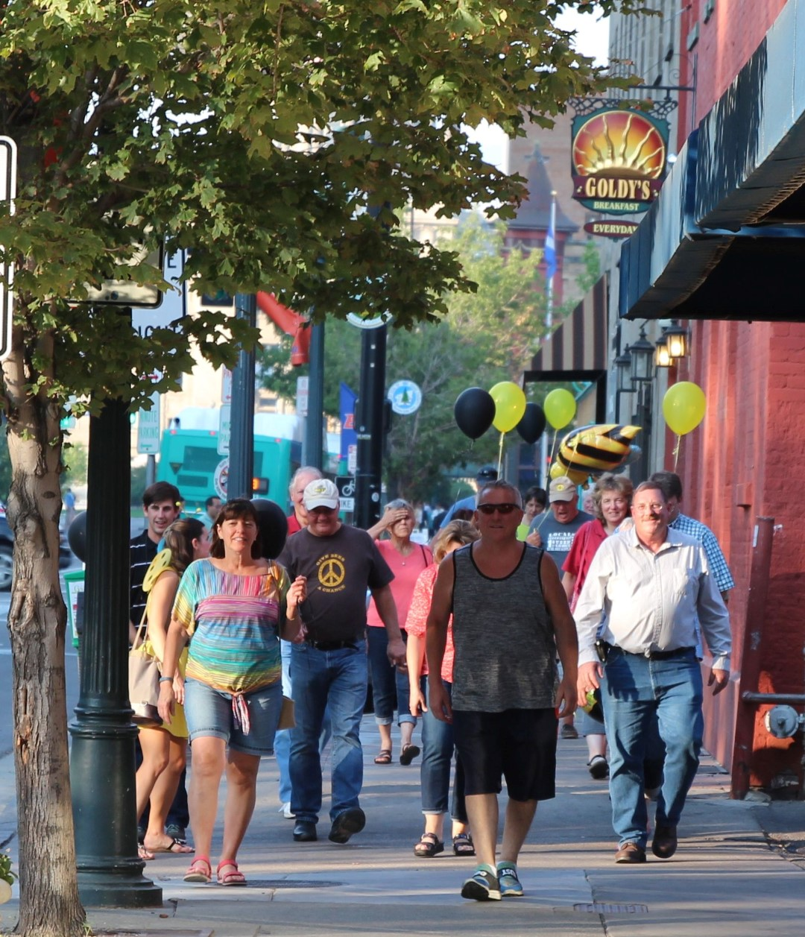
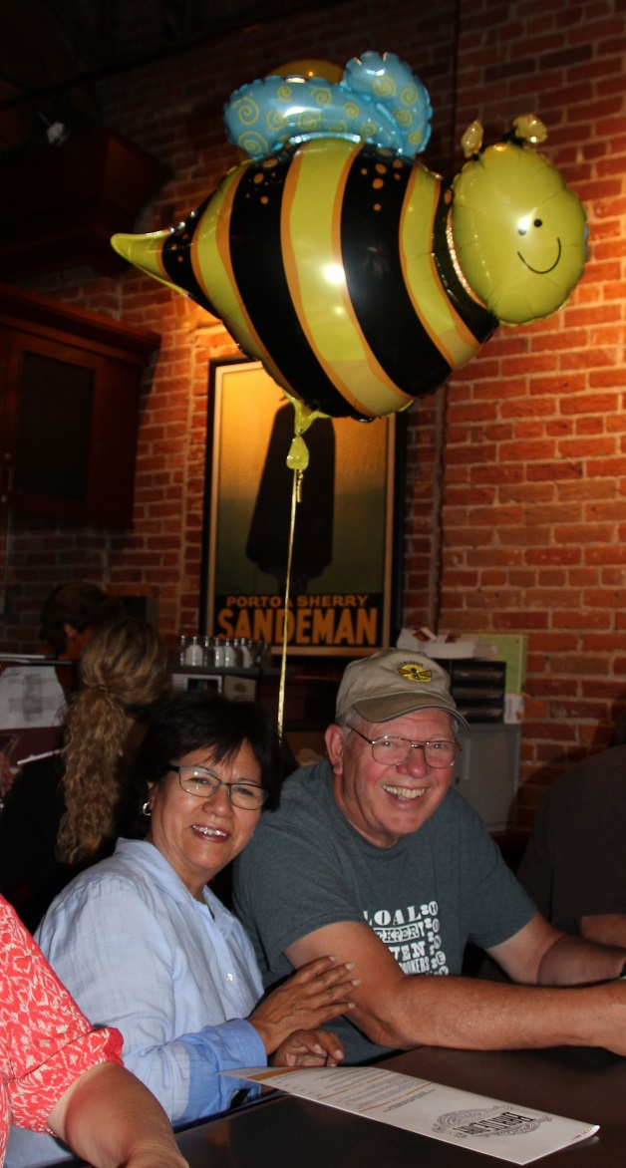
Treasure Valley Beekeepers Club
National Honey Bee Day 2015

Slide 10
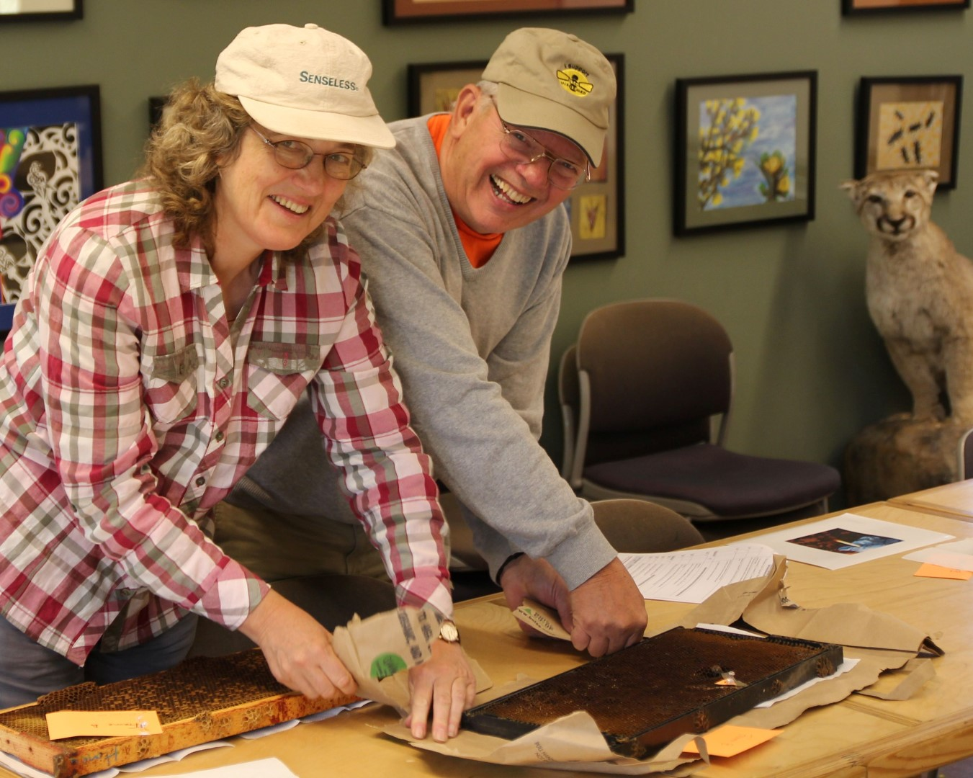
Treasure Valley Beekeepers Club
National Honey Bee Day 2015
TVBC – Oregon Master Beekeeping Program – Journey Practical Exams

Slide 11
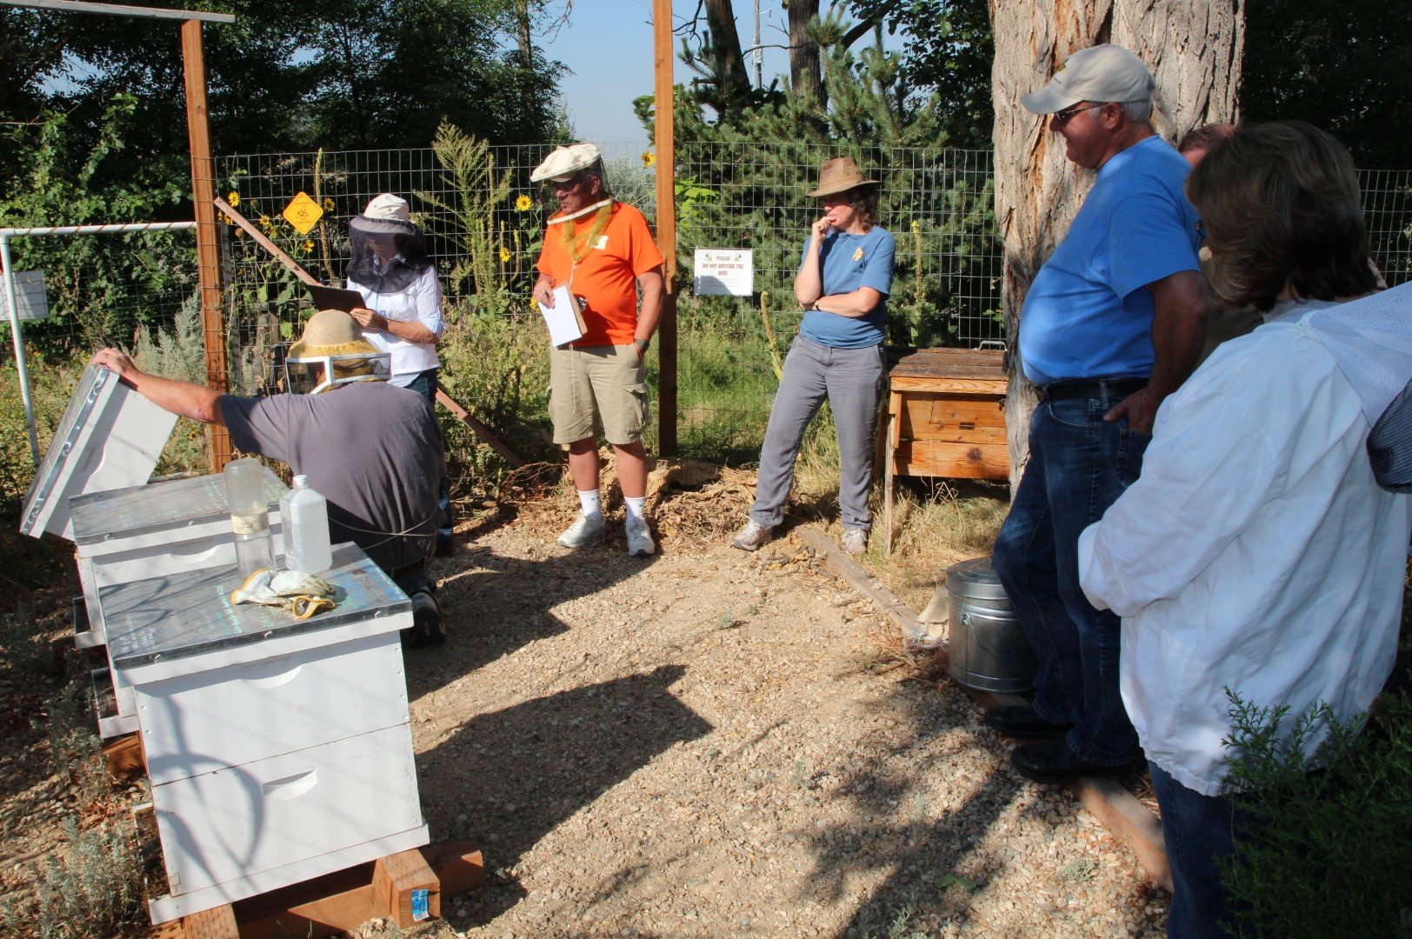
Treasure Valley Beekeepers Club
National Honey Bee Day 2015

Slide 12
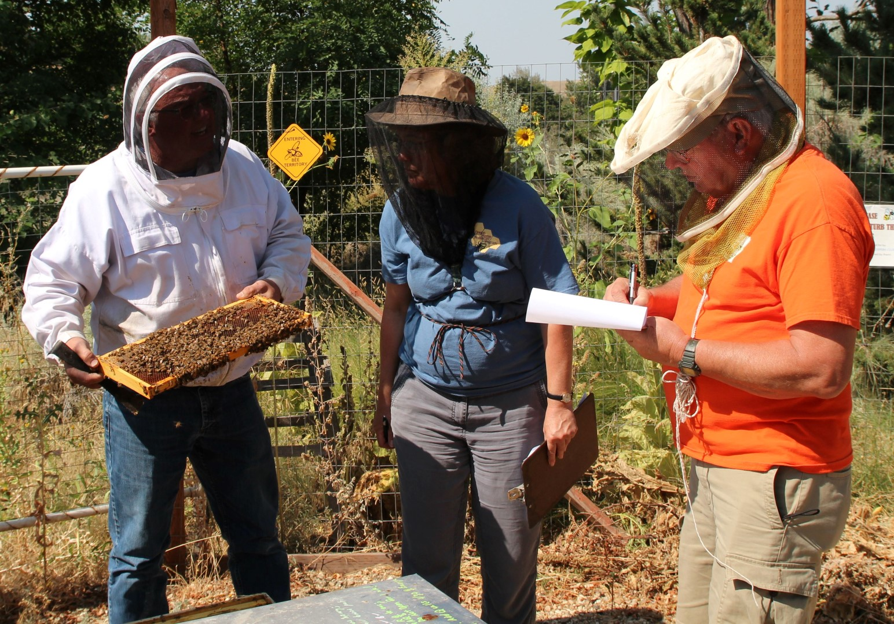
Treasure Valley Beekeepers Club
National Honey Bee Day 2015

Slide 13
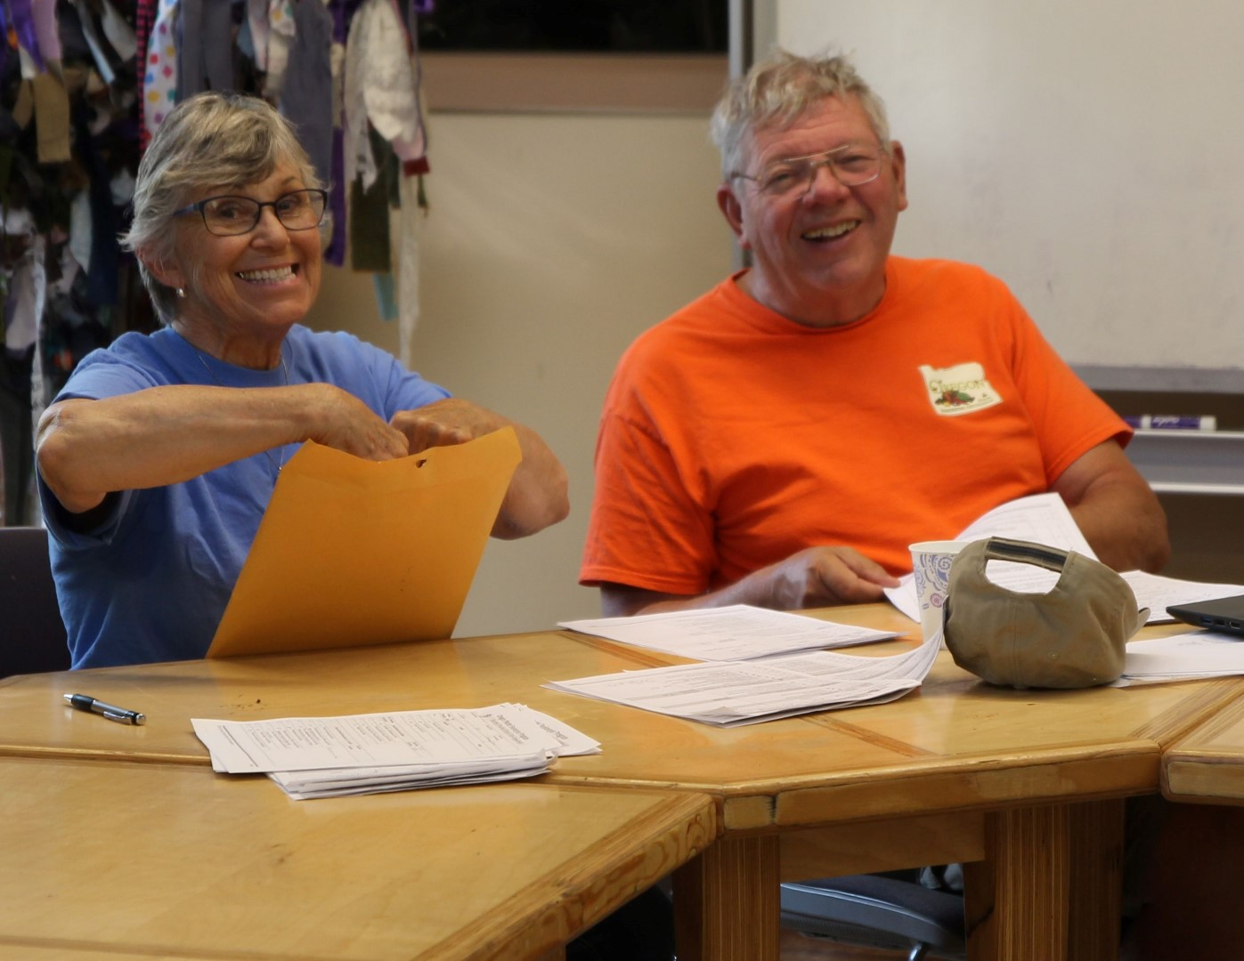
Treasure Valley Beekeepers Club
National Honey Bee Day 2015

Slide 14
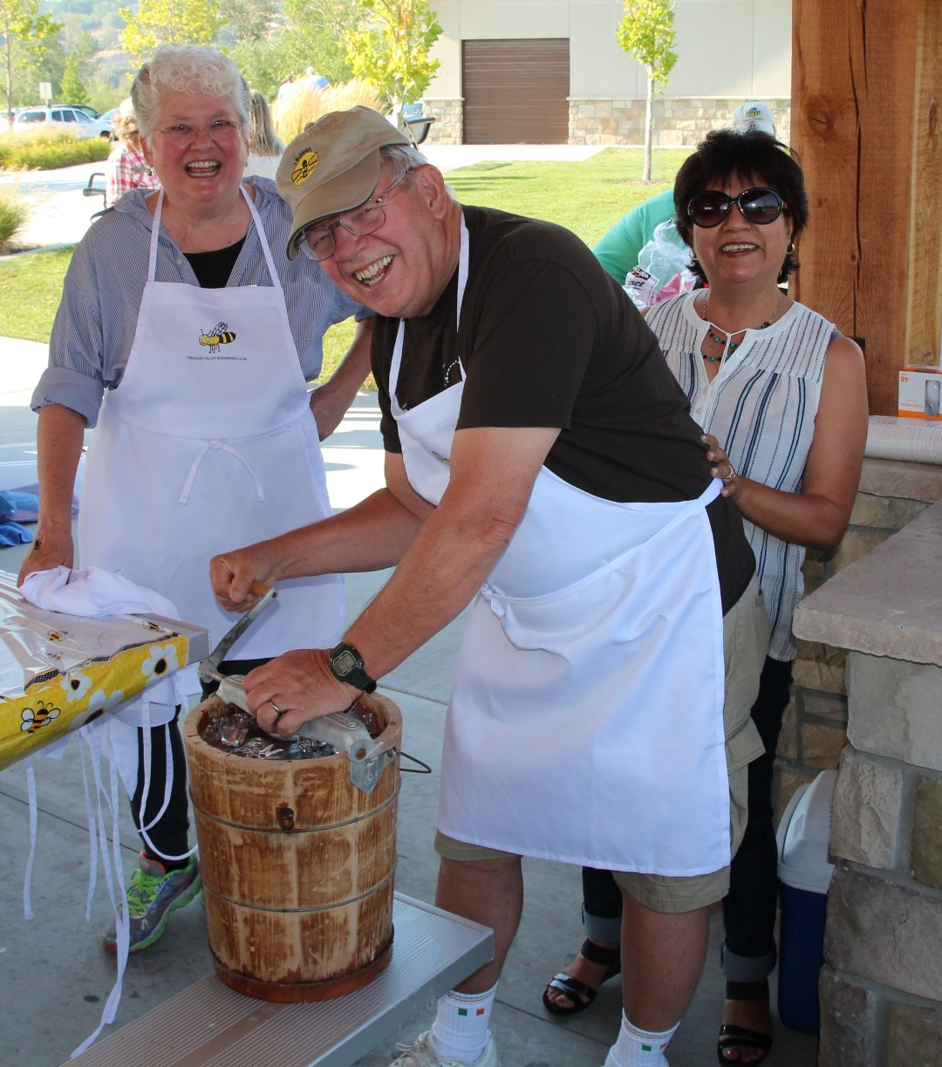
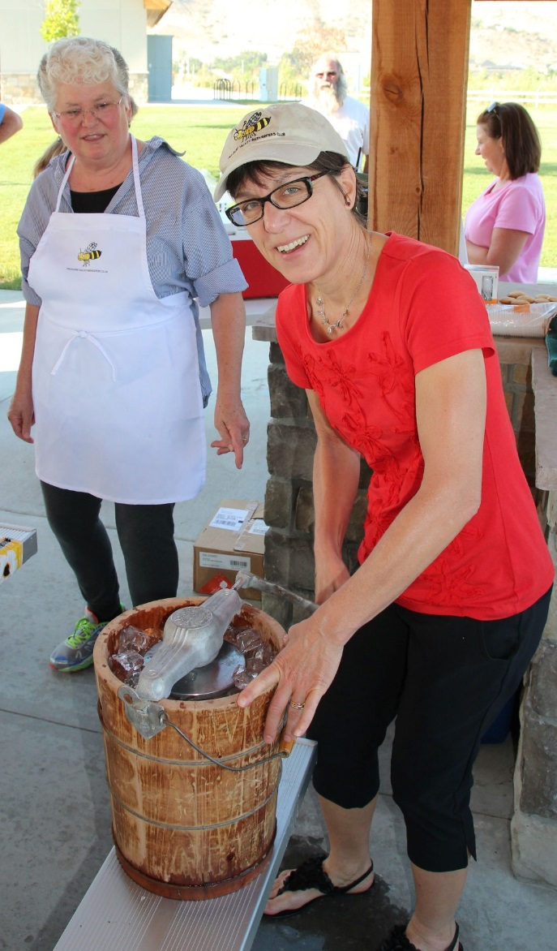
Treasure Valley Beekeepers Club
National Honey Bee Day 2015
TVBC – Second Annual National Honey Bee Day Club Picnic

Slide 15
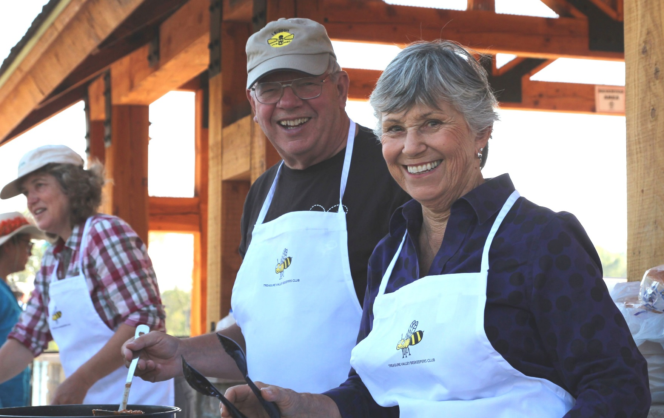
Treasure Valley Beekeepers Club
National Honey Bee Day 2015

Slide 16
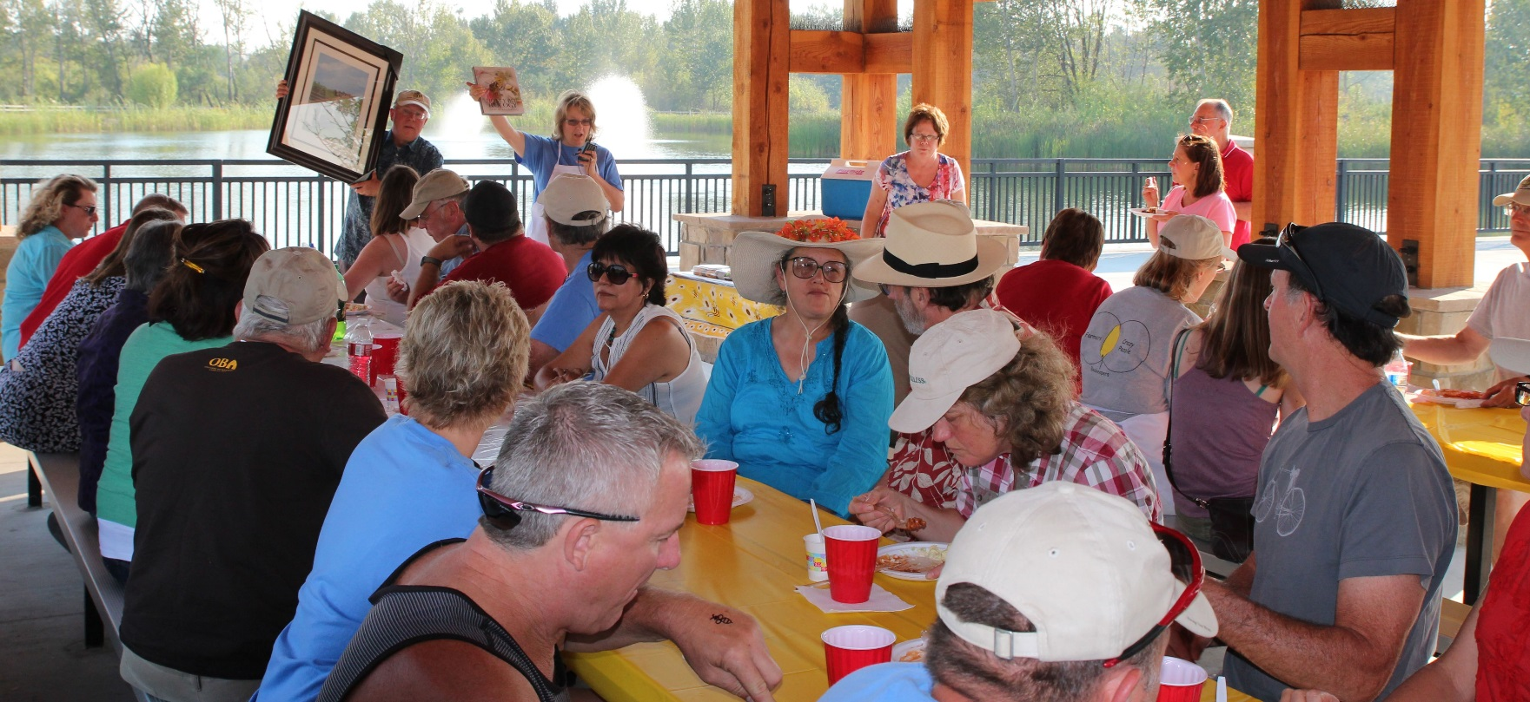
Treasure Valley Beekeepers Club
National Honey Bee Day 2015

Slide 17
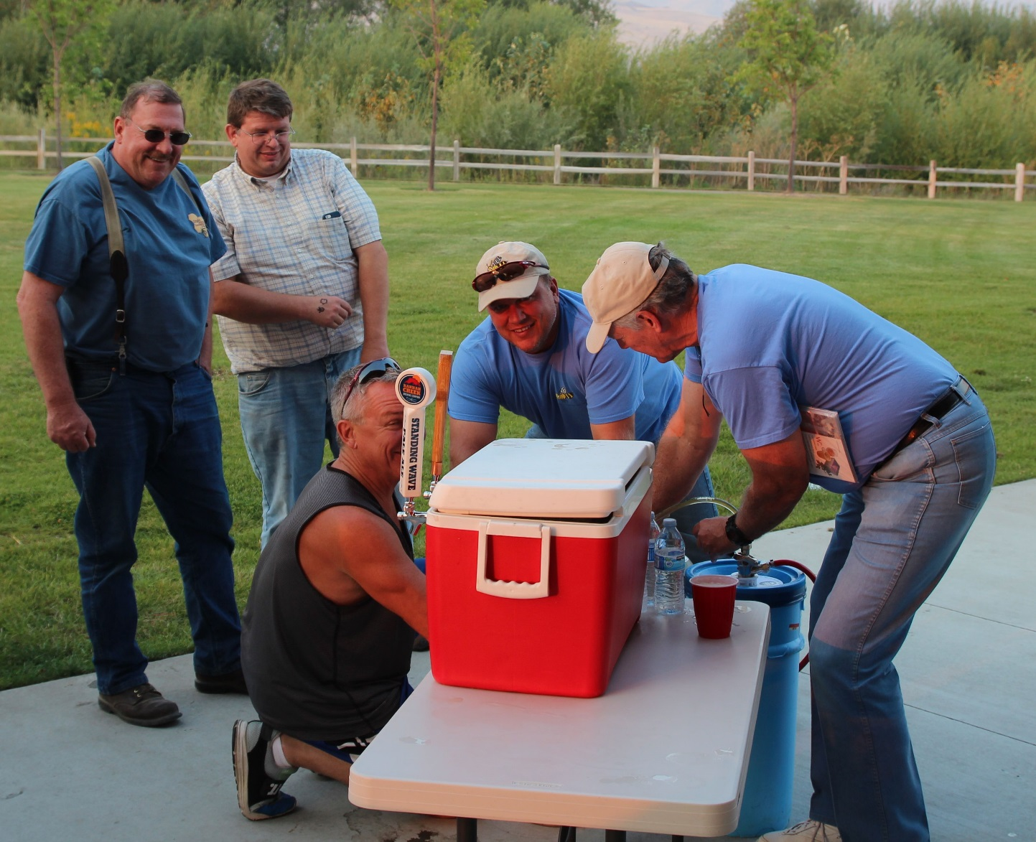
Treasure Valley Beekeepers Club
National Honey Bee Day 2015

Slide 18
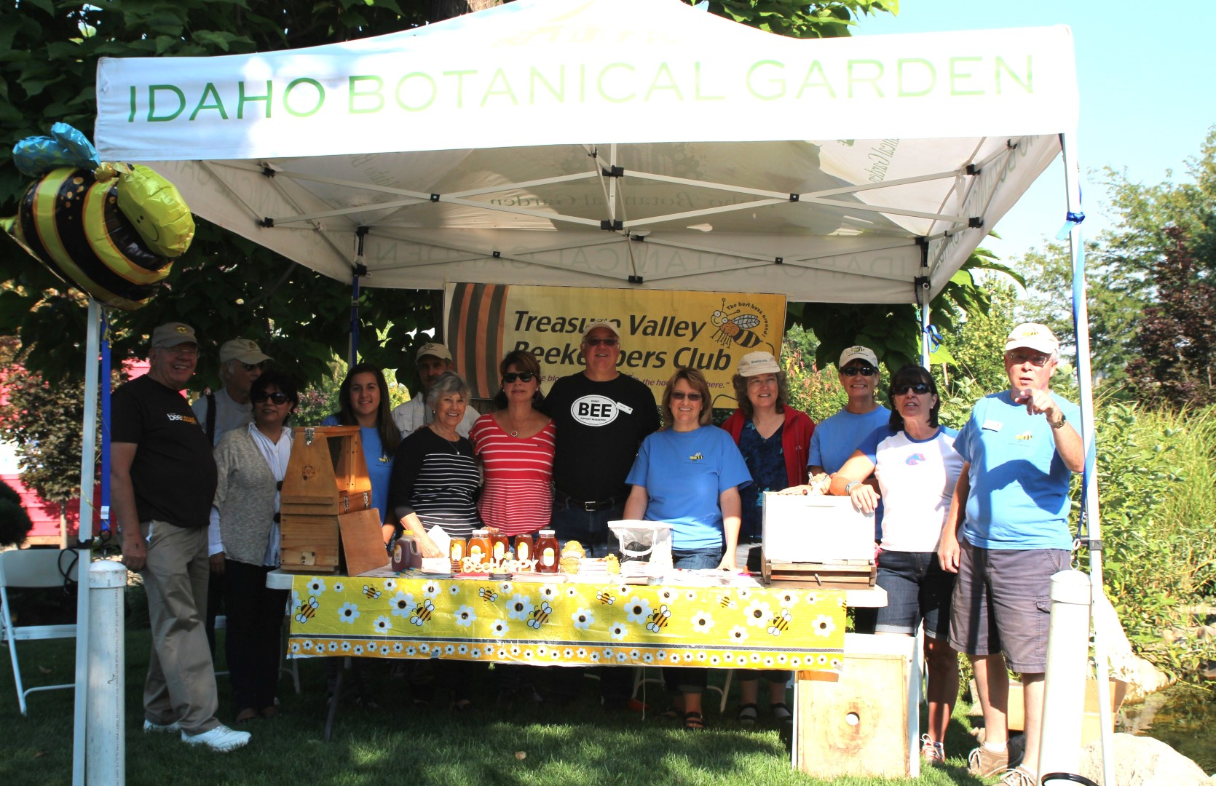
Treasure Valley Beekeepers Club
National Honey Bee Day 2015
TVBC – Bug Day at the Idaho Botanical Garden

Slide 19
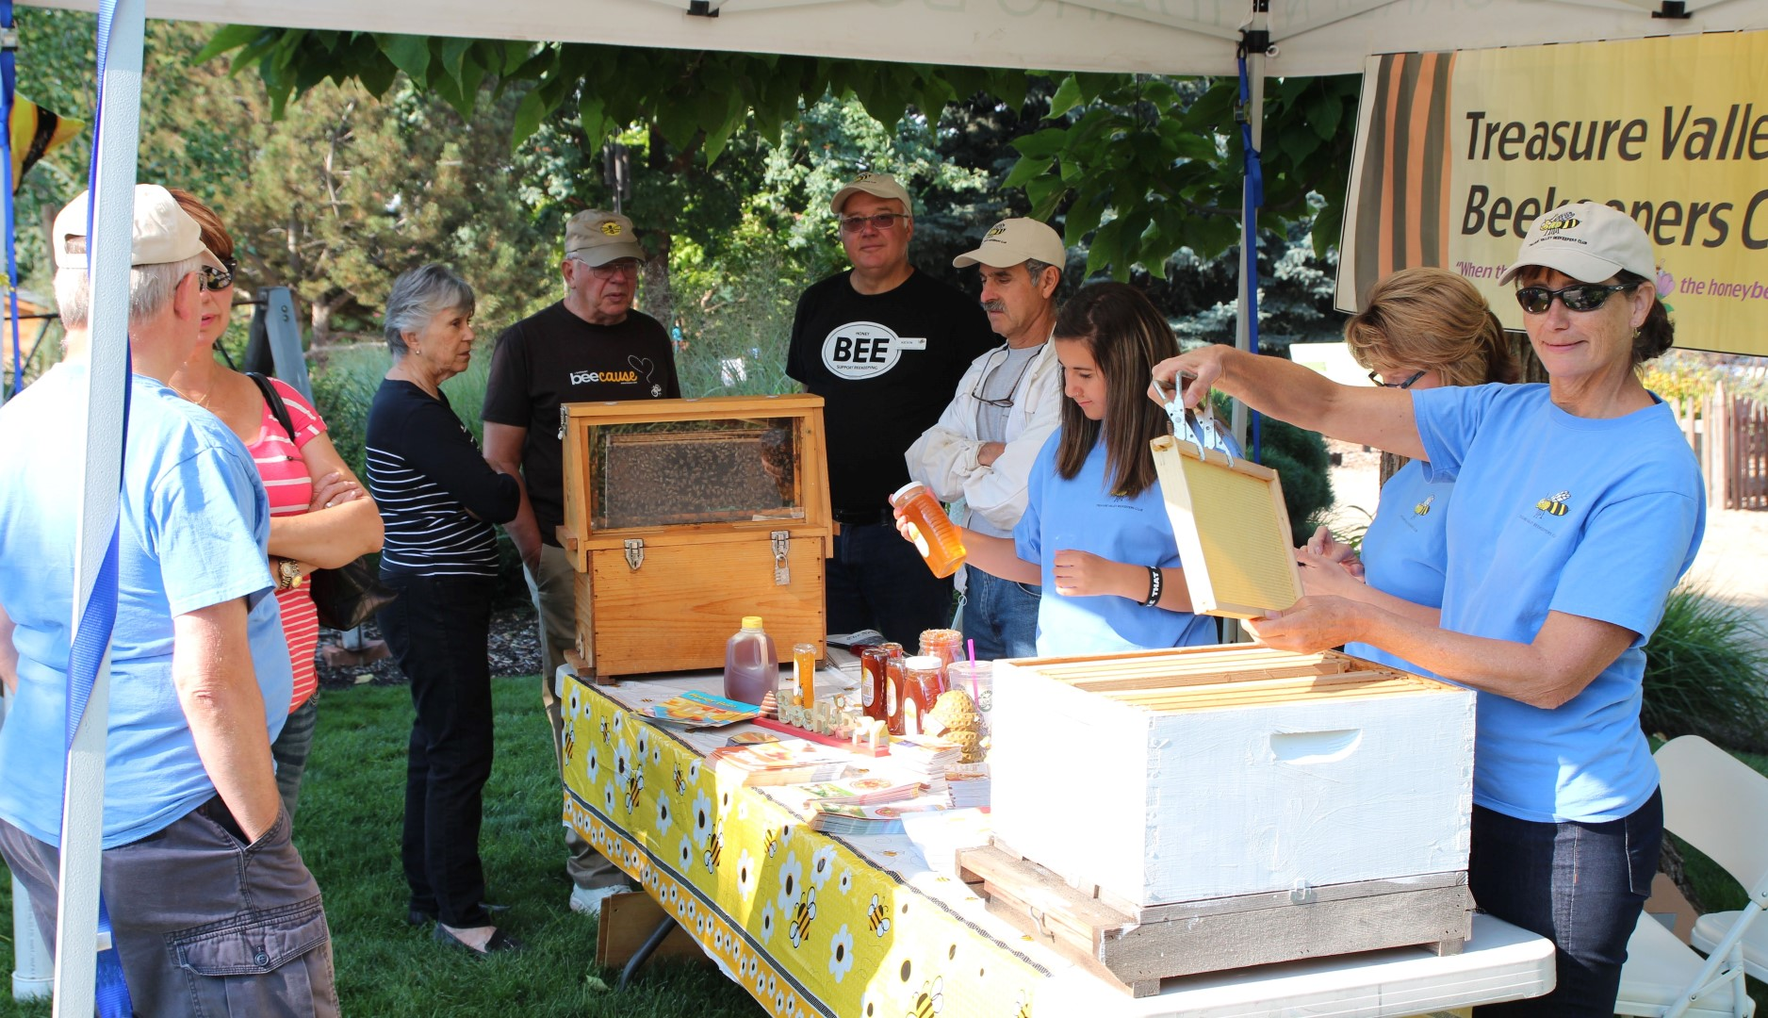
Treasure Valley Beekeepers Club
National Honey Bee Day 2015

Slide 20
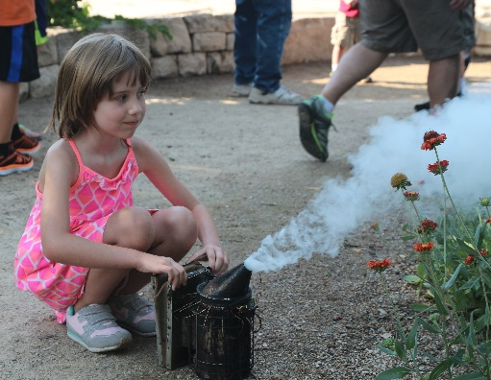
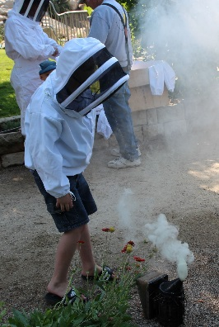
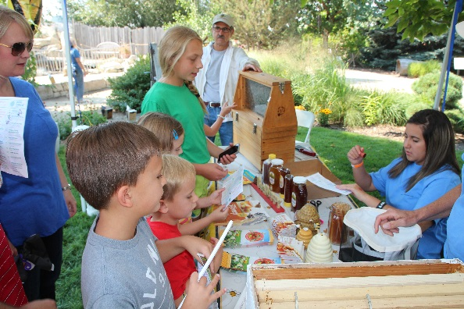
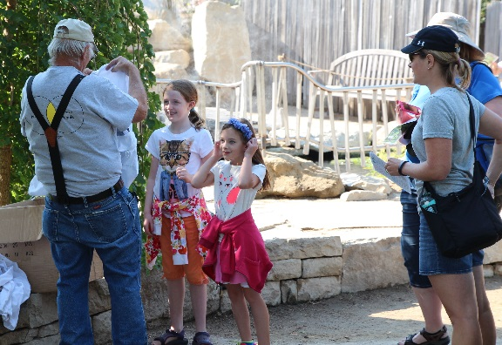
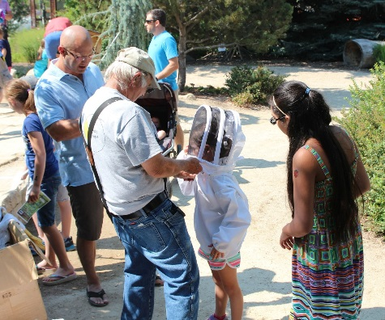
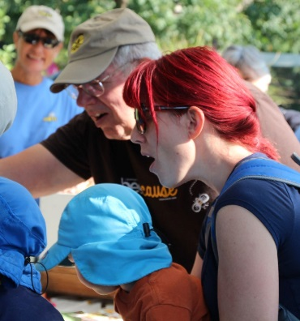
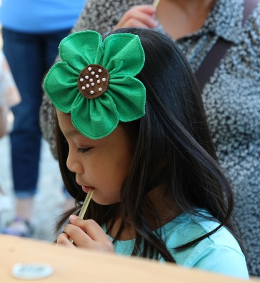
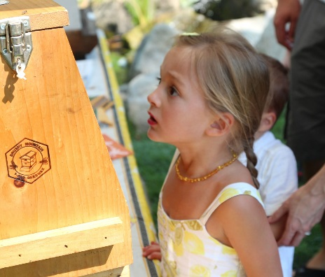
Treasure Valley Beekeepers Club
National Honey Bee Day 2015

Slide 21
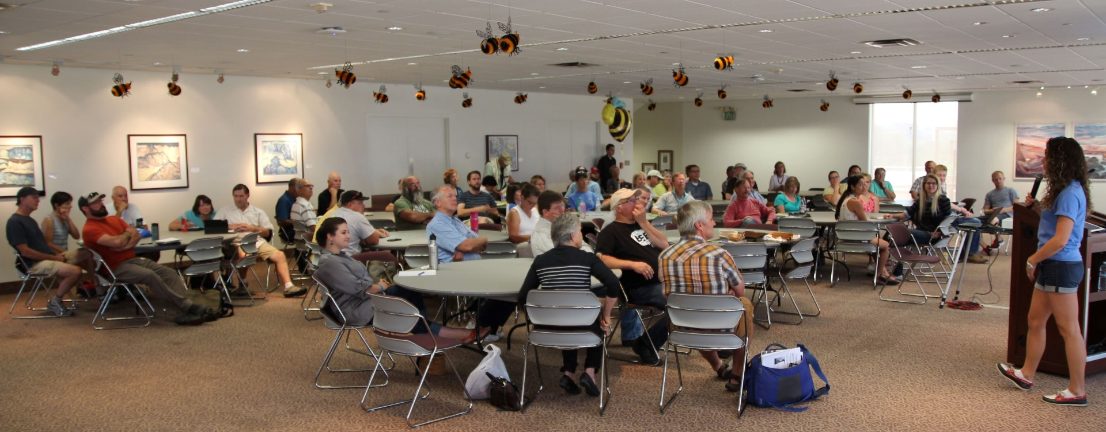
Treasure Valley Beekeepers Club
National Honey Bee Day 2015
TVBC – Keynote Presentation @ Boise State University & Roof Top Bee Farm

Slide 22
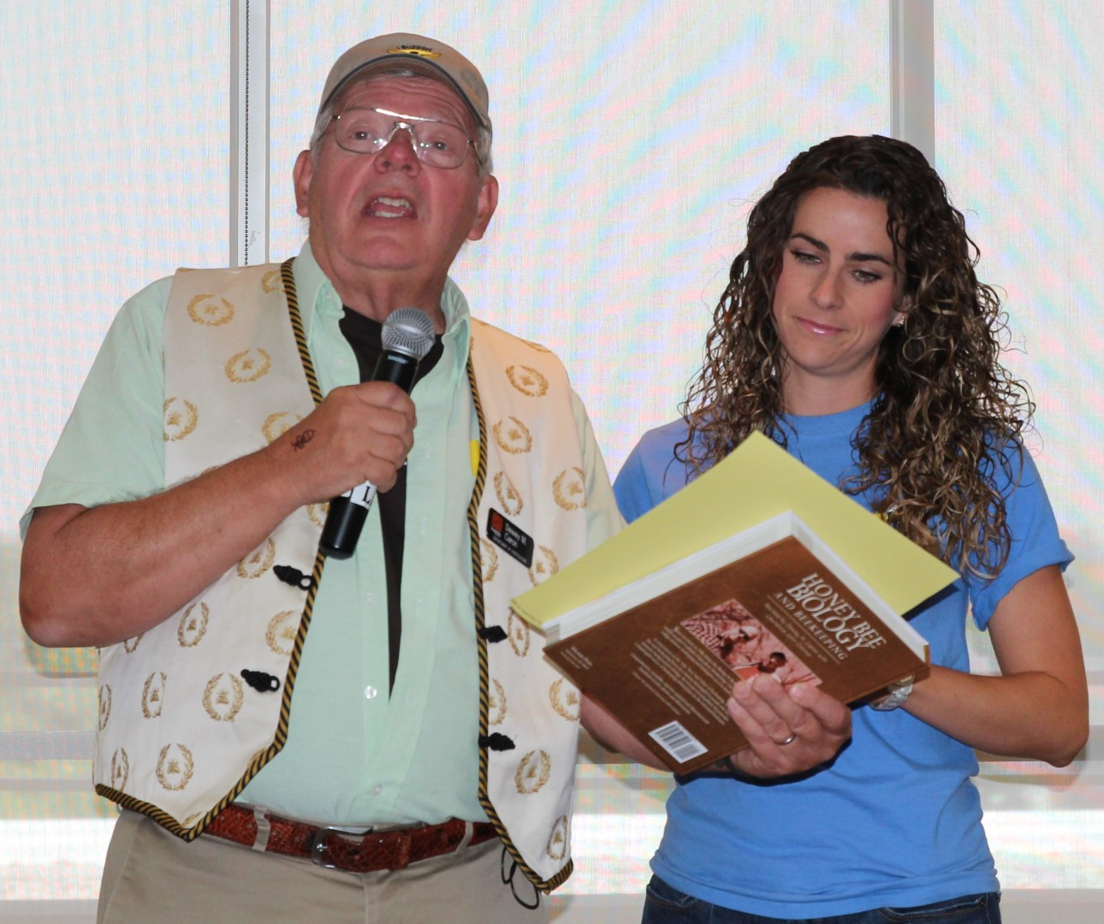
Treasure Valley Beekeepers Club
National Honey Bee Day 2015

Slide 23
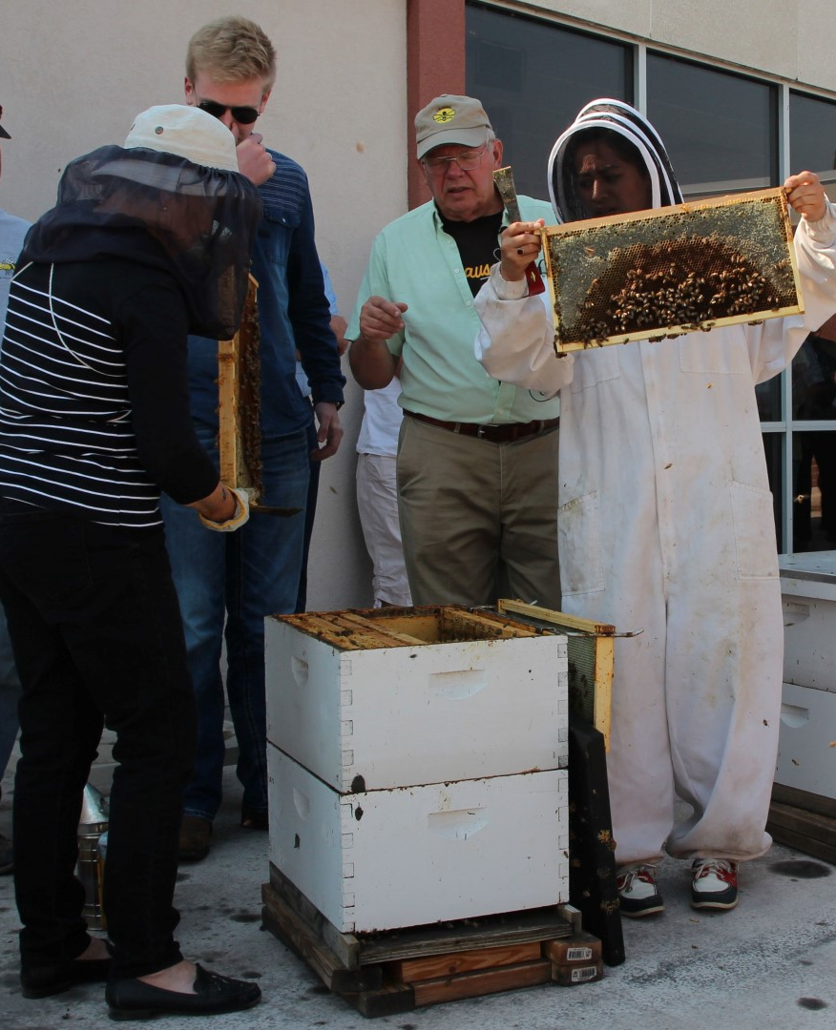
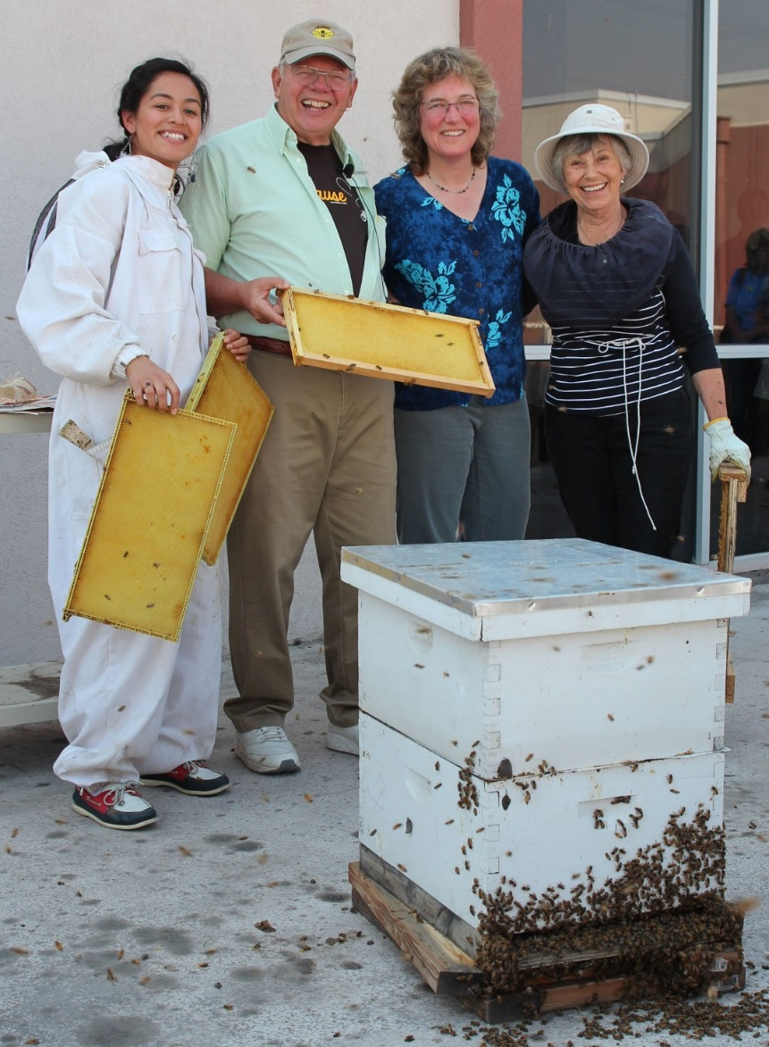
Treasure Valley Beekeepers Club
National Honey Bee Day 2015

Slide 24
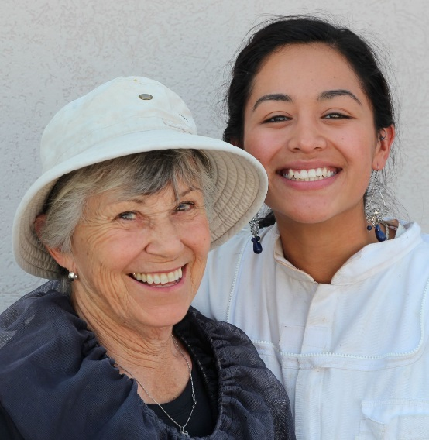
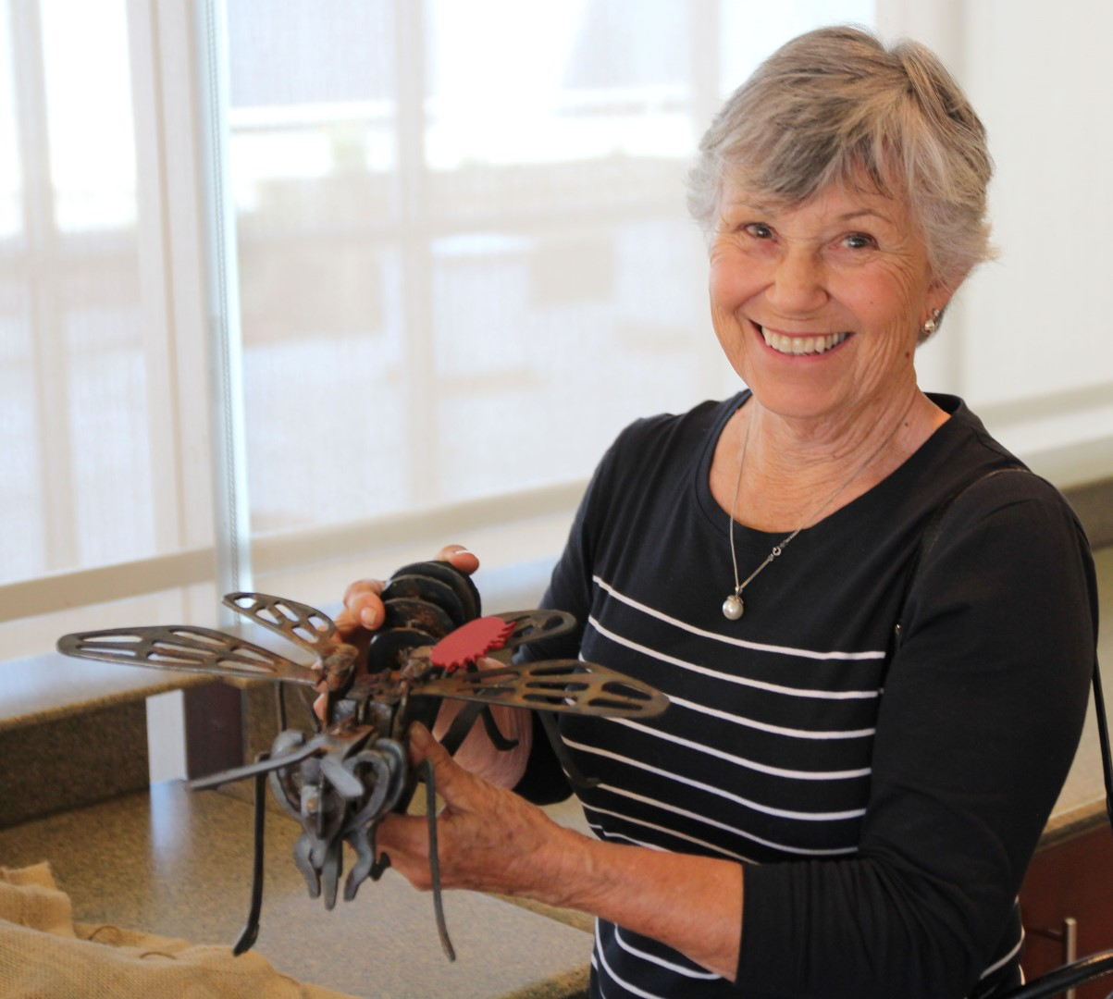
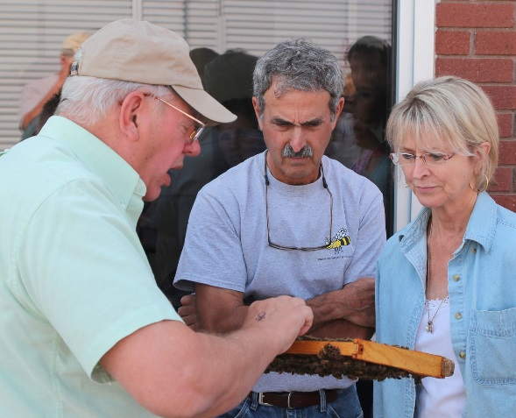
Treasure Valley Beekeepers Club
National Honey Bee Day 2015

Slide 25
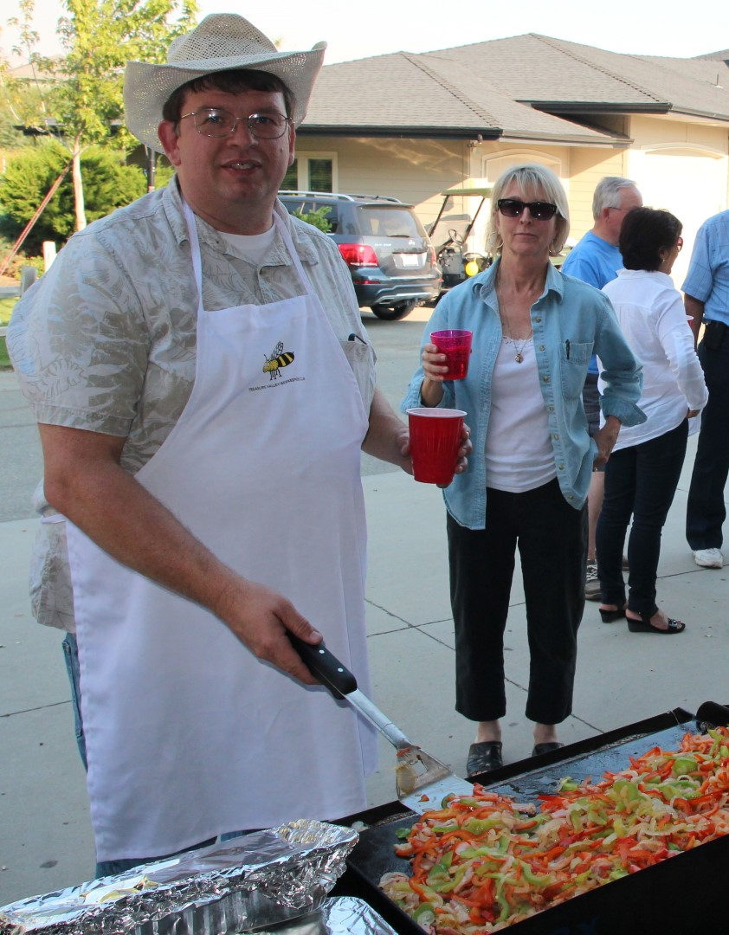
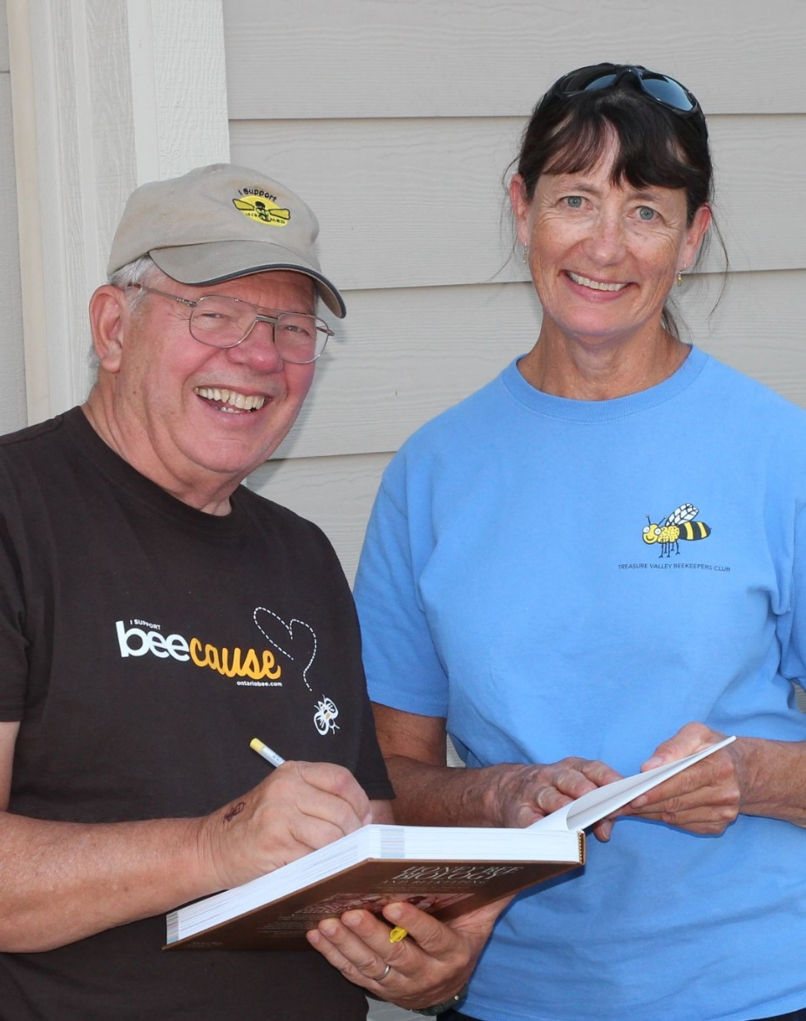
Treasure Valley Beekeepers Club
National Honey Bee Day 2015
TVBC – National Honey Bee Day Wrap-Up @ Camp Duesmanville

Slide 26
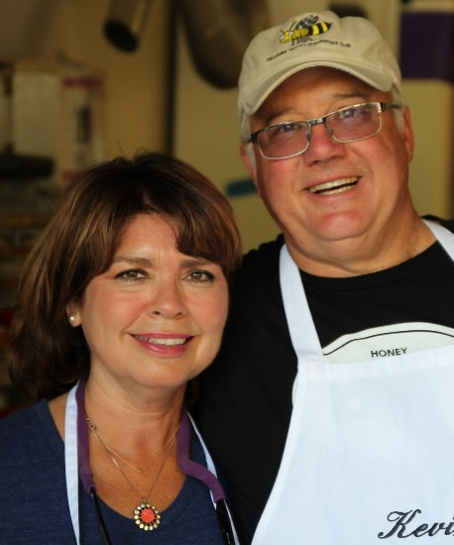
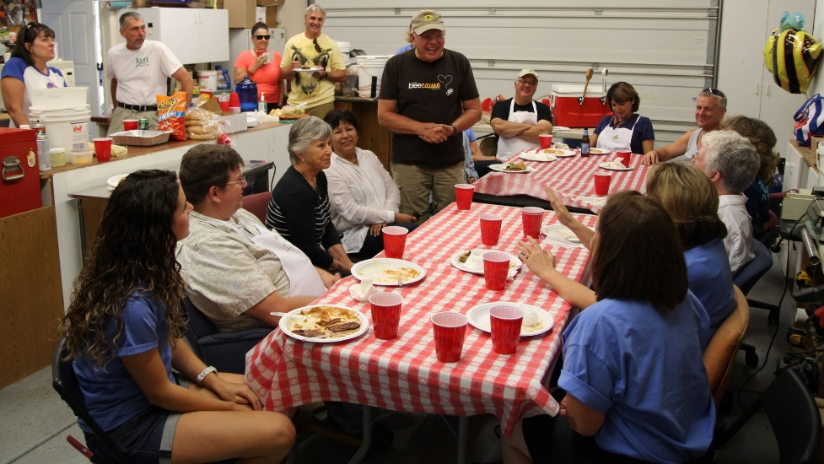
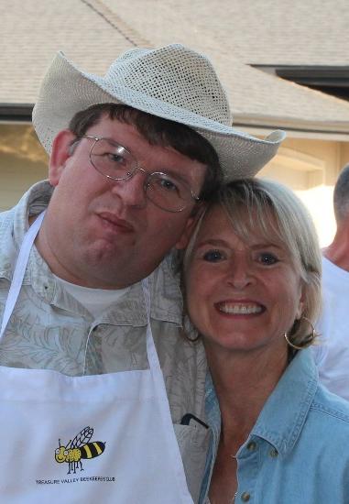
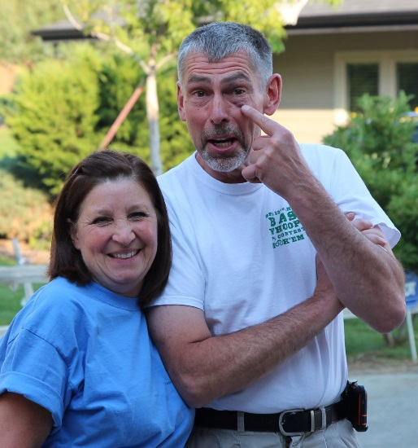
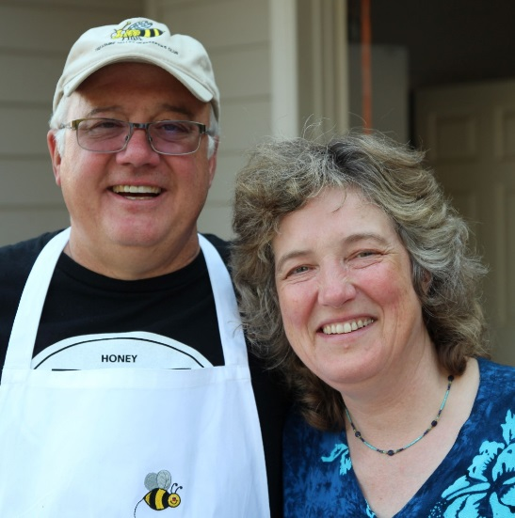
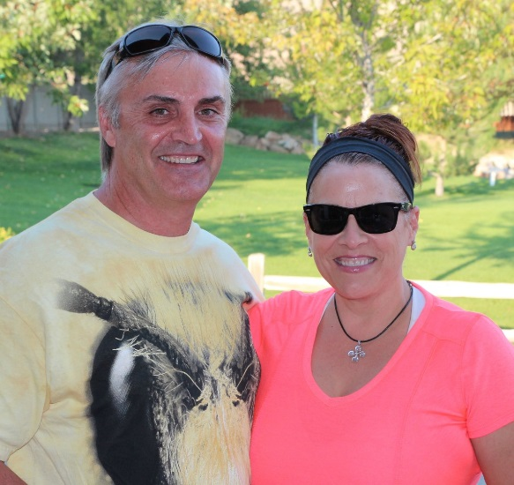
Treasure Valley Beekeepers Club
National Honey Bee Day 2015

Slide 27
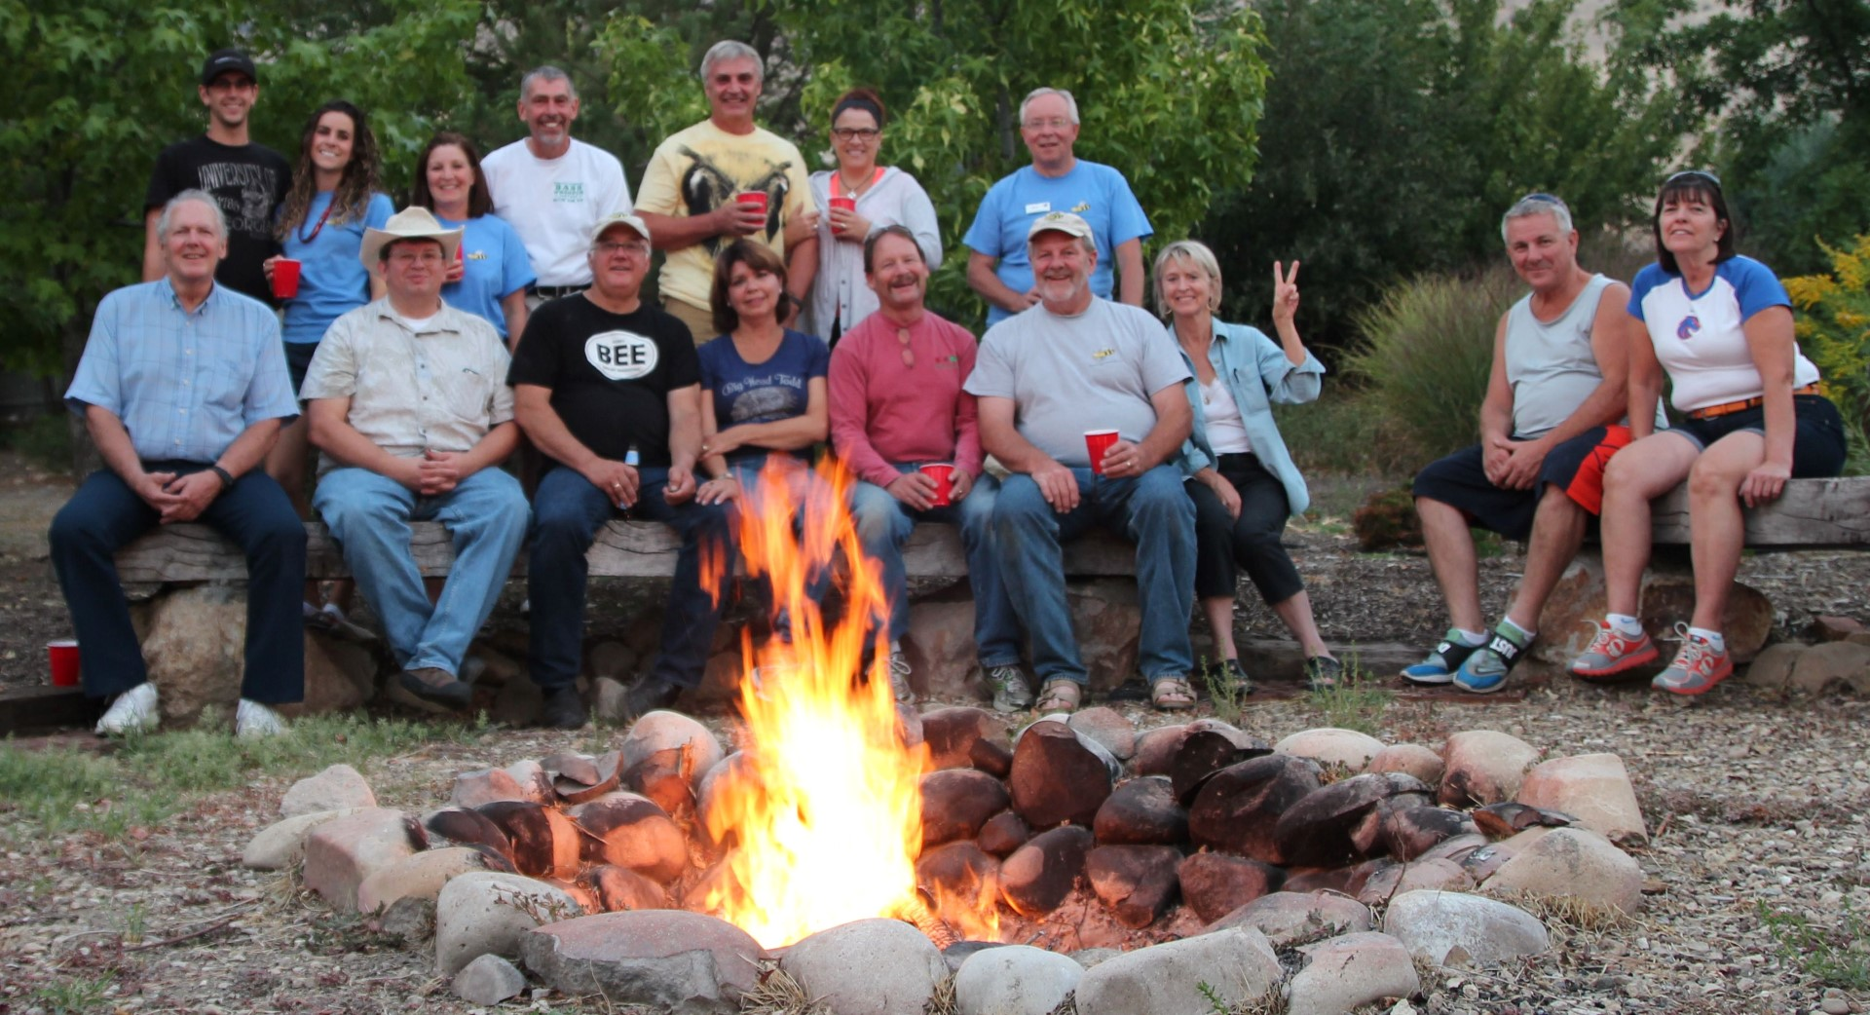
Treasure Valley Beekeepers Club
National Honey Bee Day 2015
TVBC – National Honey Bee Day Wrap-up: CampfireTales

Slide 28
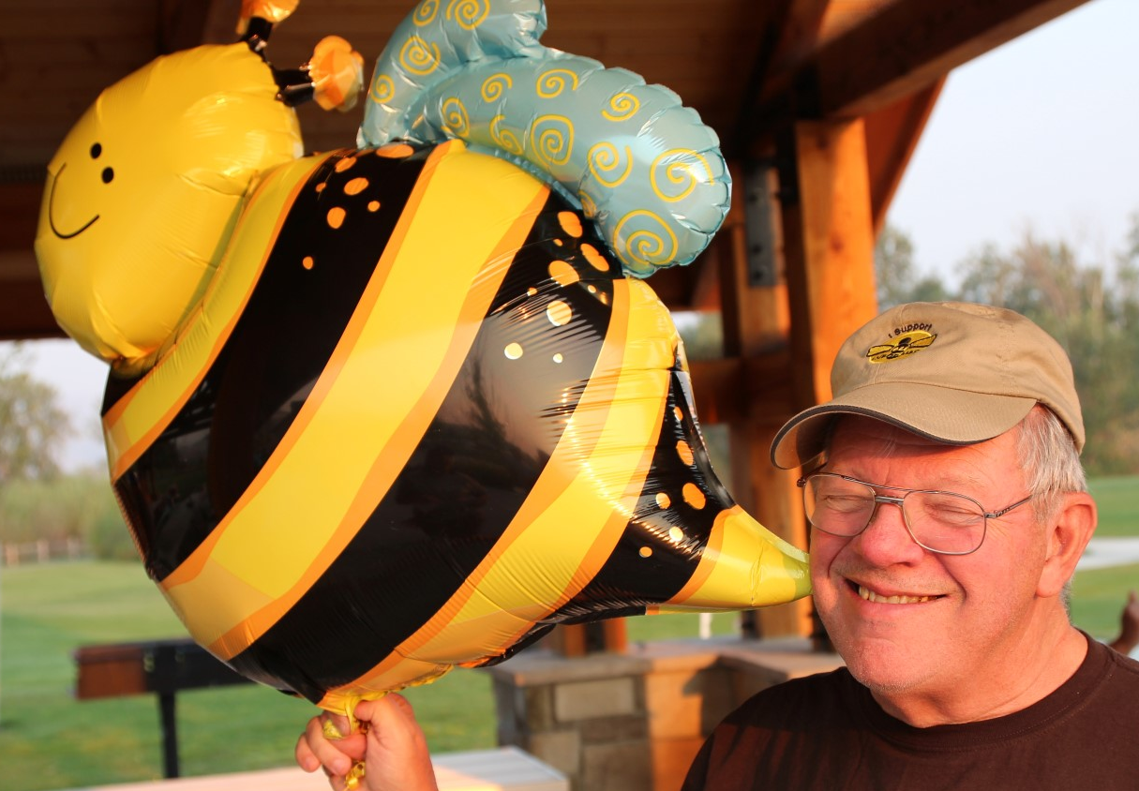
Treasure Valley Beekeepers Club
National Honey Bee Day 2015
SPECIAL THANKS TO:
Dr. Dewey & Nieves Caron, Jan Lohman, Heike Williams, Liz & Kebin Duesman, Melinda and Sam Stafford, Joe Leckie, Carole Kanizar, Rena & JB Alexander, Megan & Steve Montague, Jeff Bergland, Frank Grover, Karla Kimball, Joyce Gebhardt, Ken Sonnen, Roxanne Brown, Don Bracy, Alan Herzfeld,
Don & Darla Larson, Terry Fackerell, & BSU Beatriz!

