Slide 1
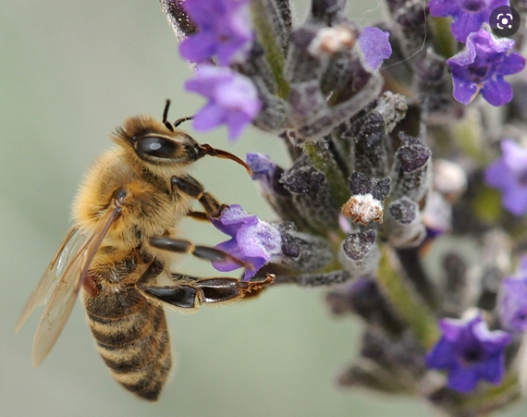
Mite Treatments – TVBC July 2021

Slide 2
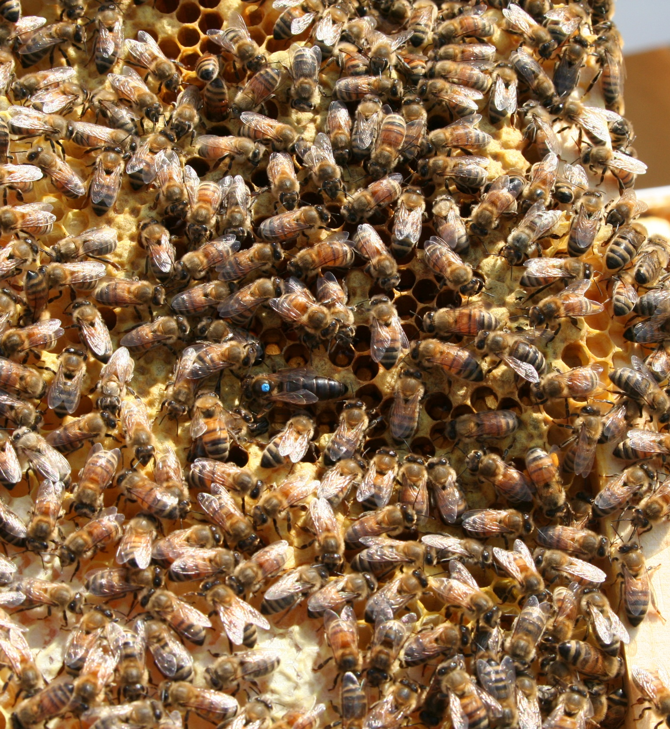
A Few Notes
Mites Don’t Kill
Any Treatment CAN Kill
Read the Instructions
Mite Counts are Essential

Slide 3
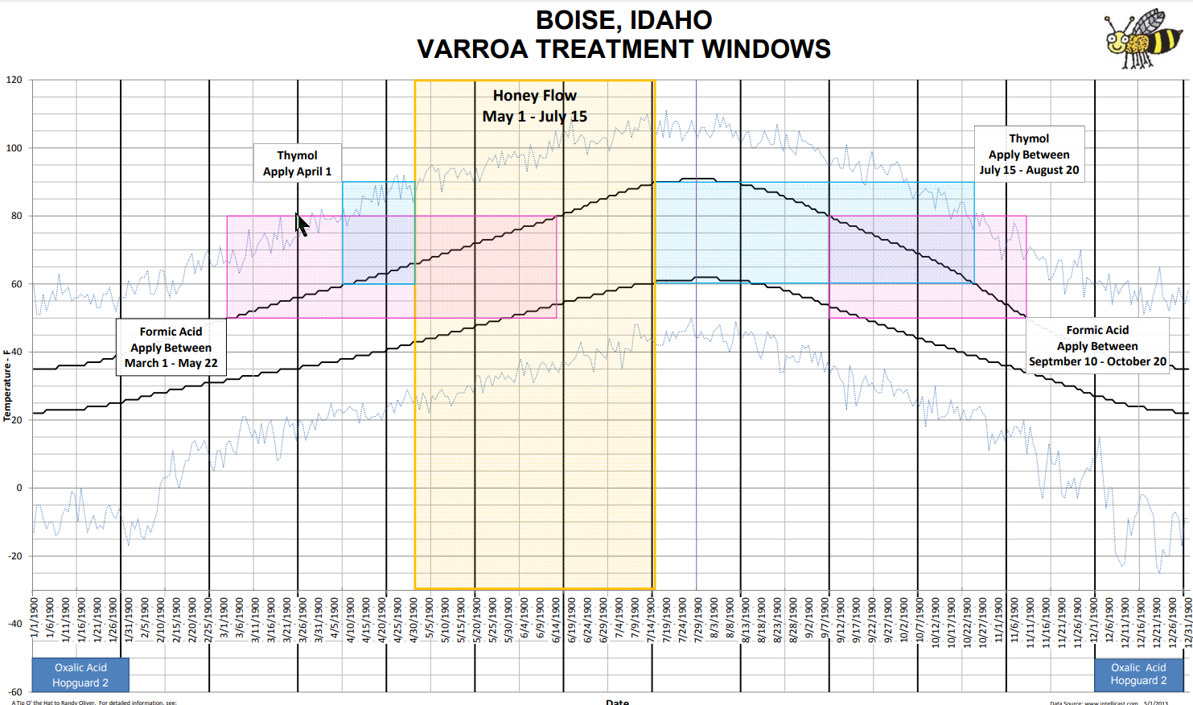

Slide 4
The Big Four
Hop Acid – HopGuard 3
Thymol - Apiguard
Oxalic Acid
Formic Acid - MAQs

Slide 5
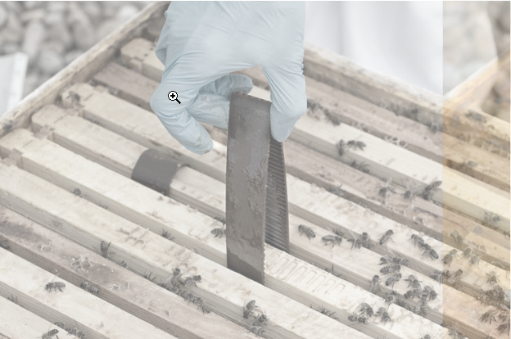
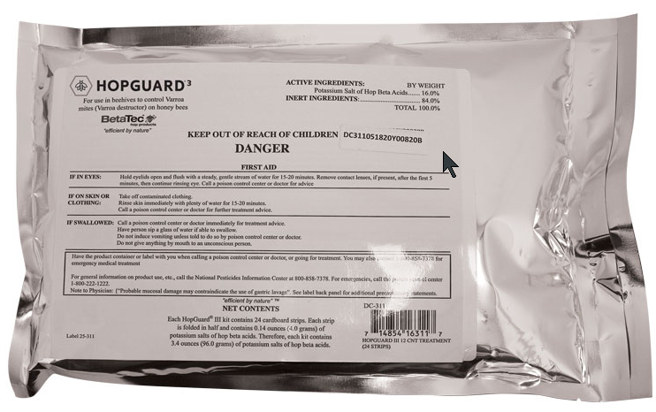
HopGuard
Temps 52 – 92 Degrees
Effectiveness 70 – 85%
Supers? Yes
Queen Loss Low
Storage 1 Yr (2 months for opened packages)
Cost $9.20 per Hive
Notes Messy – Wear Gloves. Needs to be Removed Quickly

Slide 6
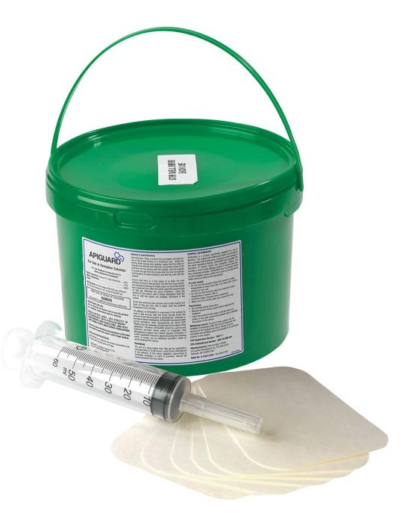
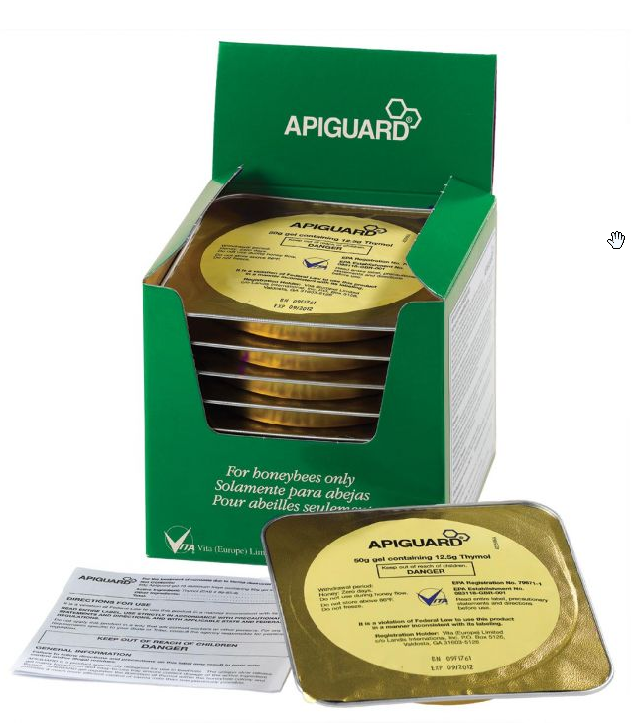
Thymol (Apiguard)
Temps 60 – 100 Degrees
Effectiveness 85 - 95%
Supers? No
Queen Loss Low
Storage 1 Year
Cost $3.40 or $7.20 per Hive
Notes Will flavor honey in the hive

Slide 7
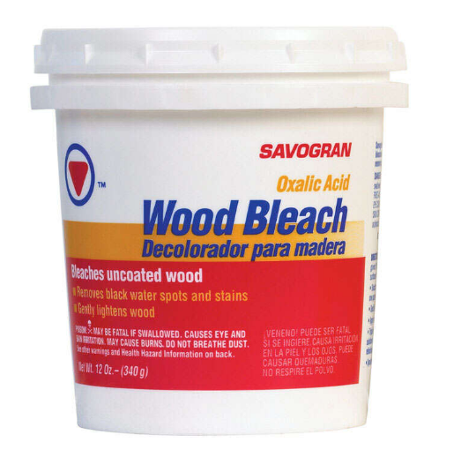
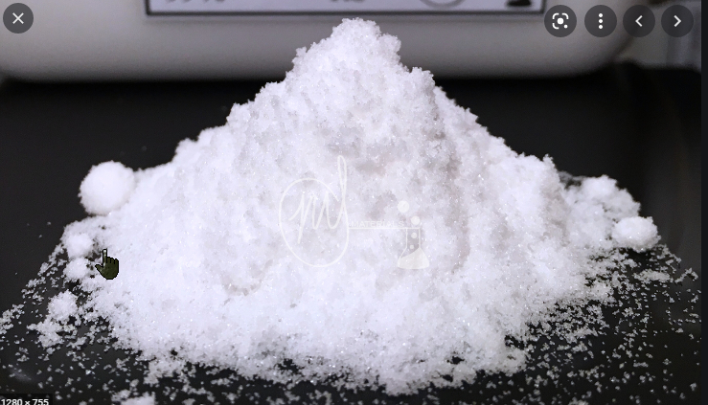
Oxalic
Temps 32 – 100 Degrees
Effectiveness 90 - 95%
Supers? Yes
Queen Loss Low
Storage No expiration if kept dry
Cost $0.06 per Hive
Notes Caustic – take precautions. Don’t breathe vapors

Slide 8
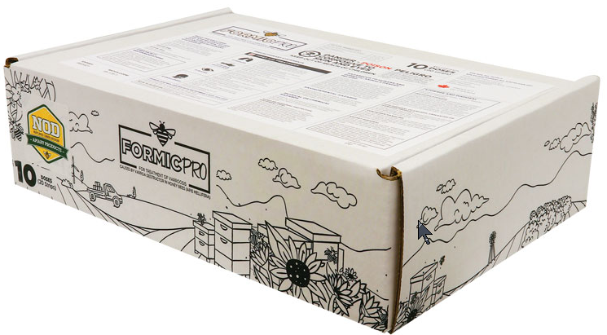
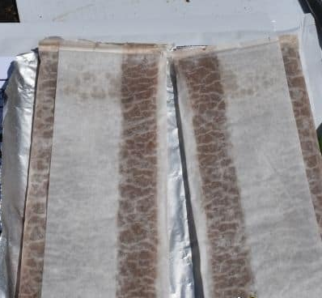
Formic MAQ Strips Formic Pro
Temps 50 – 85 Degrees
Effectiveness 83 - 97%
Supers? Yes
Queen Loss High
Storage 2 Years
Cost $3 - $6 per Hive
Notes Caustic – Don’t Breath Fumes!

Slide 9
In a Nutshell
Treatment | Cost Per Hive | Effectiveness | Temperatures | Supers? | Queen Loss | Below Caps
Oxalic | 6 Cents | 90 - 95% | 32 - 100 | Yes | Low | No
Hop Guard | $9.20 | 70 - 85% | 52 - 92 | Yes | Low | No
Thymol | $3.4 - $7.2 | 85 - 95% | 60 - 100 | No | Low | No
MAQ | $3 - $6 | 83 - 97% | 50 - 85 | Yes | High | Yes

Slide 10
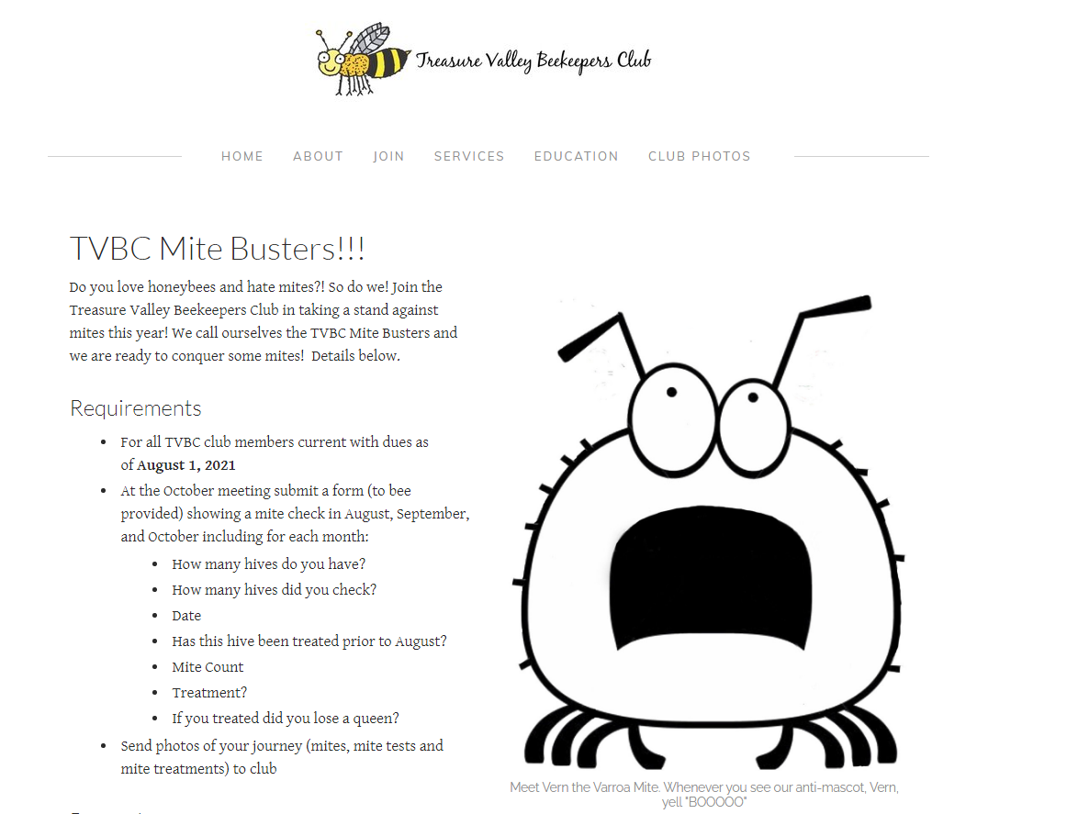

Slide 11
