Slide 1
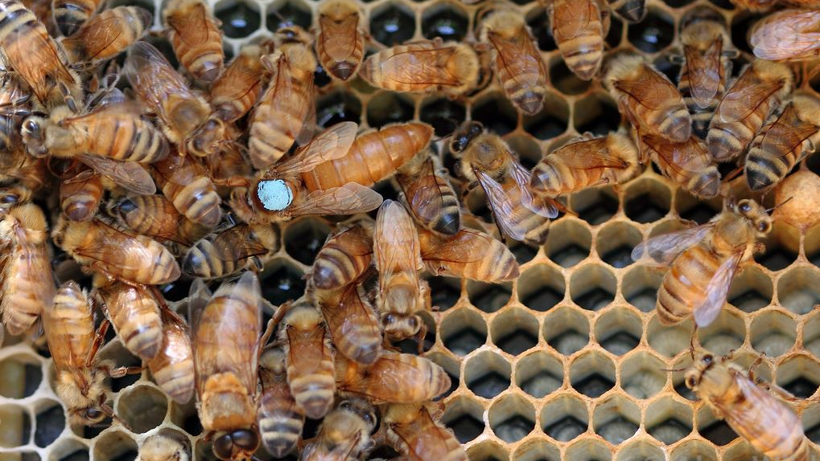
TVBC Queen Rearing Program Proposal

Slide 2
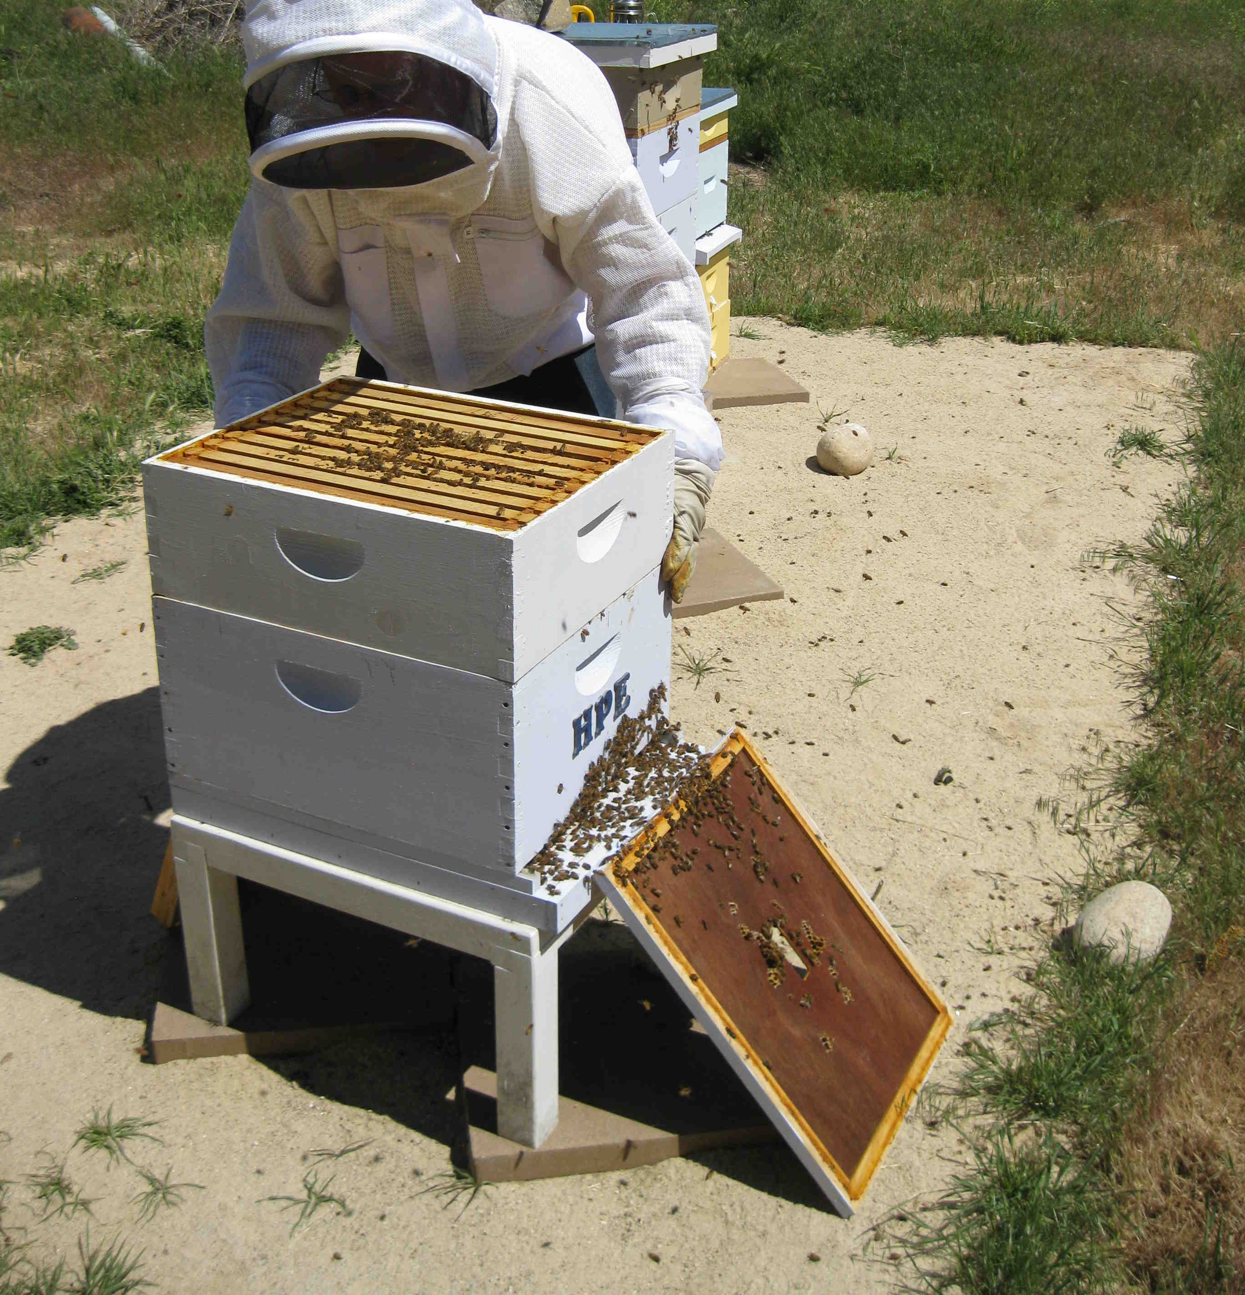
Program Objectives
Cultivate Local “Super” Queens
Mite Resistant
Mild Temperament
Good Honey Production
Supply Queen Cells to TVBC Members
Supply Fertilized Queens to TVBC Members

Slide 3
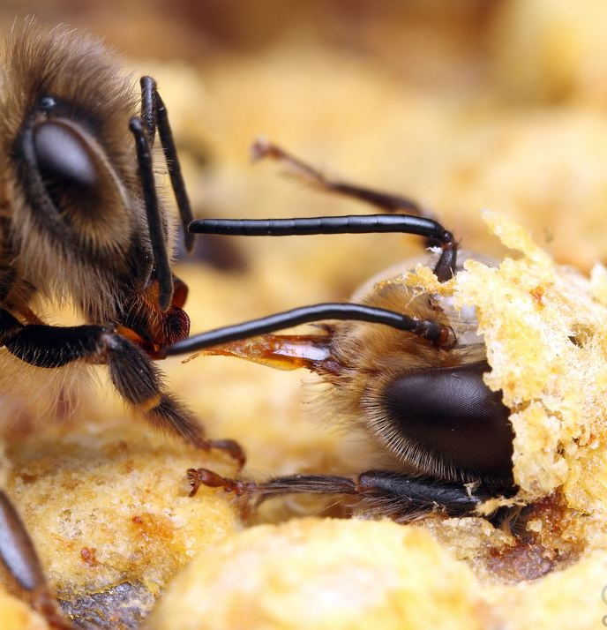
Milestones and Timeline
Year 1
Find Good Queen Stock
1st Year Queens
Year 2
Graft From Queens Identified in Year 1
Queen Cells Available to Program Participants
Year 3
Graft From Queens Identified in Year 2
Make Queen Cells Available to All Members That Have Taken Class
Establish Breeding Area
Limited Number of Mated Queens
Year 4
All the Above Plus Mated Queens for Sale

Slide 4
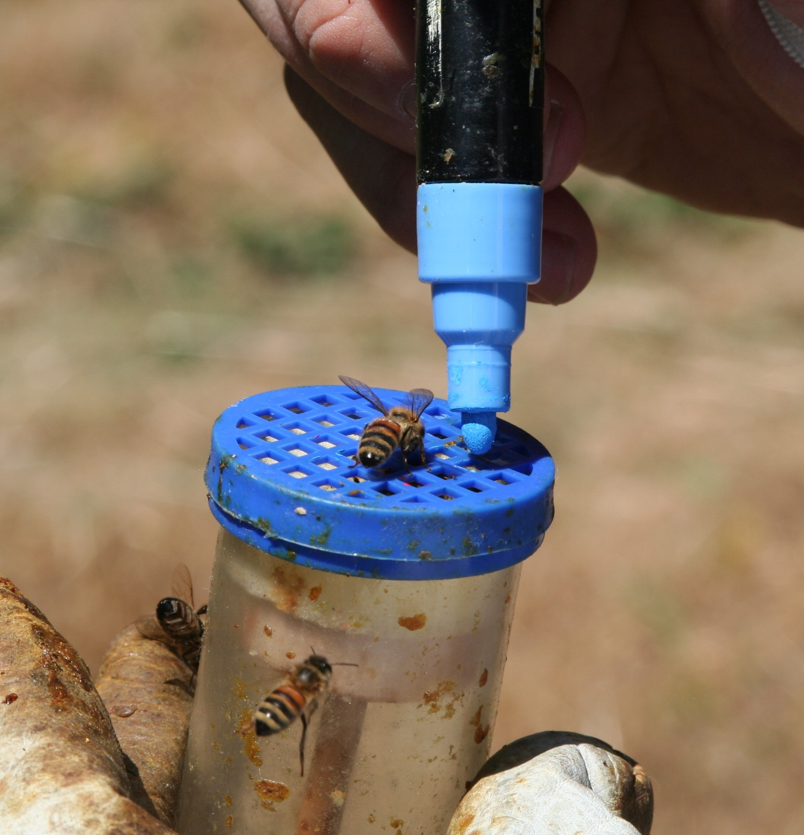
Benefits of Participation
Communication and Expertise of Team
Availability of Replacement Queens and Cells
Mite Count “Kits” Supplied
Help Take Club to Next Level

Slide 5
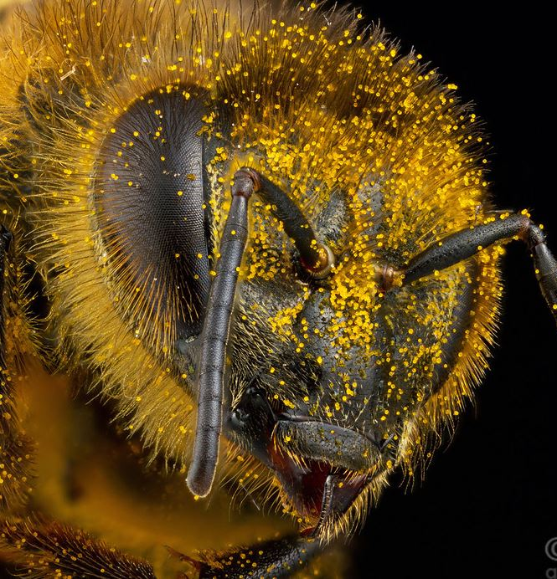
Requirements of Participation
Mite Counts in Apl, Jun, After Extraction, Sep, Oct
Email Inspections Sheets w/ Mite Counts
Agree to Queen Grafting if Selected

Slide 6
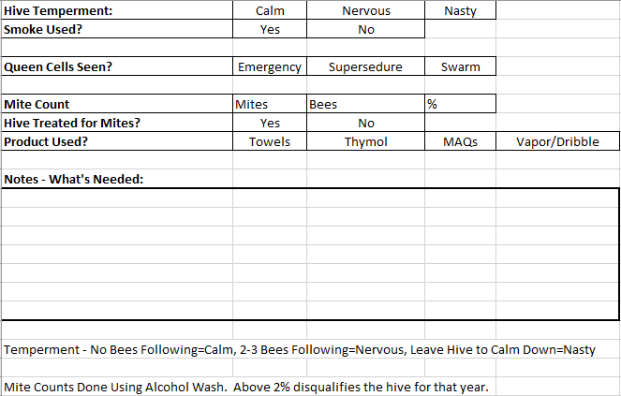
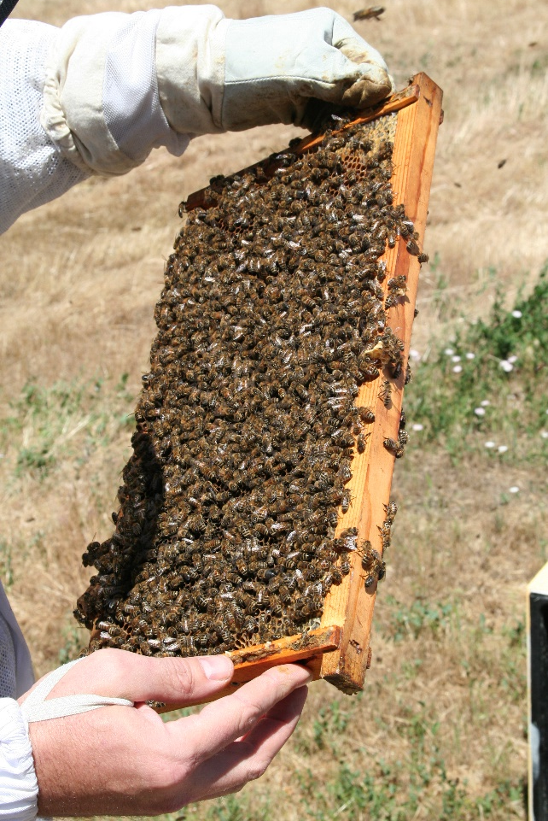
Hive Inspection Sheet

