Slide 1
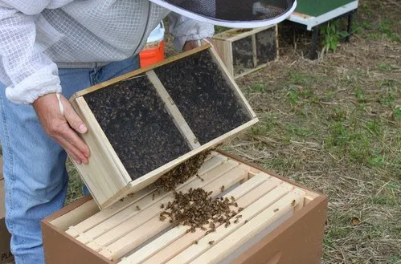
Installing Bee Packages

Slide 2
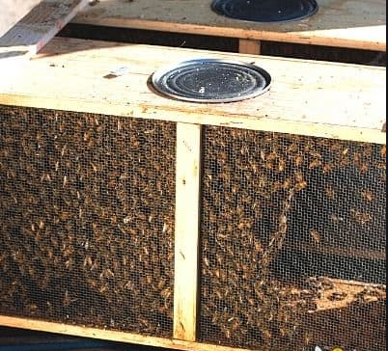
Transporting your Package
Keep the package in a cool dark area until ready for install
Install just before dark, but before it gets cold
Do not pack them side by side where you are blocking the screen

Slide 3
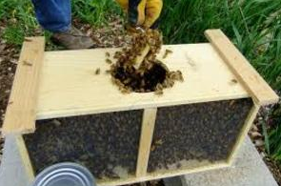
Prep The Queen
Shake Bees Down
Pull the Can w/ Hive Tool
Remove the Queen
Cover the Opening
Gently Pull the Cork from the Hole
Cover the Hole with your Finger
Stuff in a Piece of Gumdrop or Marshmallow
This guy is using nails to hang his cage. Not the most secure, and you could possibly poke the queen. He does show that you need to cover the hole so the queen doesn’t escape though.

Slide 4
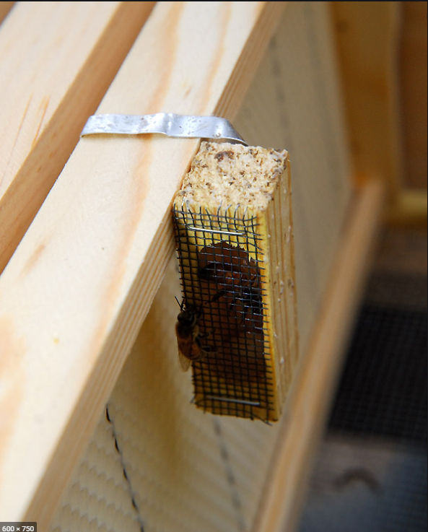
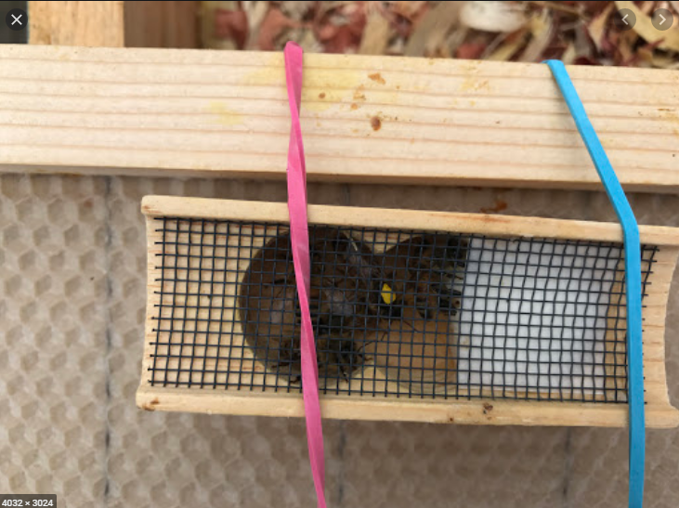
Attach Queen to Frame
If Drawn Comb, Sink into Wax
If Raw Foundation, Use Rubber Band or Tab on Cage
Absolutely, Positively Expose Screen so Bees can Feed Her
Note how the screen side is facing out. If you were to push frames together, it would cover the queen and she would die. Face the screen up or down, NOT like this “expert” did.

Slide 5
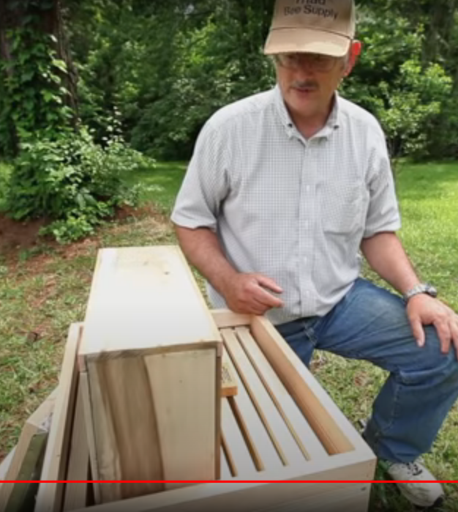
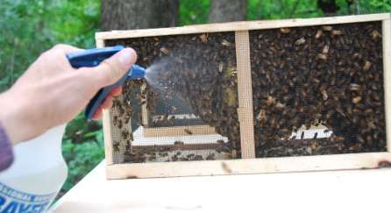
Two Box Method
Spray Package Lightly with 1:1 Sugar Syrup
Knock Down the Bees
Holding onto your Cover, Invert the Hole Over the Queen
Remove the Cover
Place Empty Box Around Package
Put on Inner Cover and Telescoping Lid
Note the queen cage with no attendant bees. Do not assume the bees will find her in time. If you use this method, put a scoop of bees on the queen cage to keep her alive until the rest of the box finds her. Another expert giving bad advice.

Slide 6
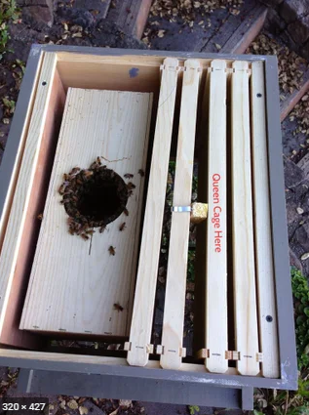
One Box Method – Only If It’s Warm Enough
Remove Five Frames From Box
Queen is in Between Frames in Hive
Lightly Spray the Bees
Knock Down the Bees
Place the Package in the Open Area of the Hive
Remove the Cover
With Your Hive Tool, Gently Scoop a Pile of Bees and Place on Queen
Put on Inner Cover and Telescoping Lid
Good example of securing the queen cage. They used both the metal tab and pushing it between frames

Slide 7
If It’s Cold and You Have only One Box, Shake
Put Queen Between Frames
Knock Down the Bees
Pull the Cover and Pour the Bees on Top of the Queen
Shake the Package to get all the Bees Out
Put on Inner Cover and Telescoping Lid

Slide 8
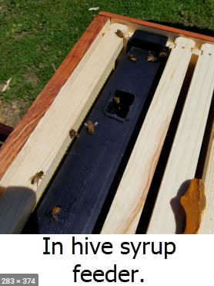
Post Install Treatment
Feed, Feed, Feed. 1:1 Sugar Syrup, Pollen Patty, Probiotics
Put in Entrance Reducer With Large Opening
Do not Bother the Bees until Day 4
Verify the Queen Released
Pull out the Box if Required
Install the Missing Frames
Perform an Oxalic Treatment if Required
I put my internal feeders on the outside position, not one frame in as shown. To fill them, you only need to “twist” the inner cover to expose the hole. Use a long neck funnel (from auto parts store) to fill up to the top. Have a small spoon ready to scoop out bees that have drowned. They will float to the top. Also note the pollen patty to the right of the feeder.

